Slide 1

Database Systems: Design, Implementation, and Management, 14e
Module 3: The Relational Database Model
Coronel, Carlos and Morris, Steven, Database Systems: Design, Implementation, and Management, 14 Edition. © 2023 Cengage. All Rights Reserved. May not be scanned, copied or duplicated, or posted to a publicly accessible website, in whole or in part.

Slide 2
Chapter Objectives (1 of 2)
By the end of this chapter, you should be able to:
Describe the relational database model’s logical structure
Identify the relational model’s basic components and explain the structure, contents, and characteristics of a relational table
Use relational database operators to manipulate relational table contents
Explain the purpose and components of the data dictionary and system catalog
Identify appropriate entities and then the relationships among the entities in the relational database model

Slide 3
Chapter Objectives (2 of 2)
By the end of this chapter, you should be able to (continued):
Describe how data redundancy is handled in the relational database model
Explain the purpose of indexing in a relational database

Slide 4
A Logical View of Data
The relational data model allows the designer to focus on the logical representation of the data and its relationships, rather than on the physical storage details
The relational model enables you to view data logically rather than physically
Logical simplicity tends to yield simple and effective database design methodologies
This section explores the details of table structure and contents

Slide 5
Tables and Their Characteristics (1 of 2)
A table is perceived as a two-dimensional structure composed of rows and columns
A table is also called a relation
You can think of a table as a persistent representation of a logical relation
  A relation whose contents can be permanently saved for future use
The domain is the set of allowable values for an attribute
The primary key (PK) is an attribute or combination of attributes that uniquely identifies any given row
The characteristics of a relational table are summarized in Table 3.1 on the following slide

Slide 6
Tables and Their Characteristics (2 of 2)
Table 3.1 | Characteristics of a Relational Table
1 | A table is perceived as a two-dimensional structure composed of rows and columns
2 | Each table row (tuple) represents a single entity occurrence within the entity set
3 | Each table column represents an attribute, and each column has a distinct name
4 | Each intersection of a row and column represents a single data value
5 | All values in a column must conform to the same data format
6 | Each column has a specific range of values known as the attribute domain
7 | The order of the rows and columns is immaterial to the DBMS
8 | Each table must have an attribute or combination of attributes that uniquely identifies each row

Slide 7
Keys
A key consists of one or more attributes that determine other attributes
Keys are important because they are used to ensure that each row in a table is uniquely identifiable
  They are also used to establish relationships among tables and to ensure the integrity of the data

Slide 8
Dependencies
The role of a key is based on the concept of determination, which is the state in which knowing the value of one attribute helps to determine the value of another
  Example: revenue – cost = profit
Functional dependence means that the value of one or more attributes determines the value of one or more other attributes
The attribute whose value determines another is called the determinant or the key
The attribute whose value is determined by the other is called the dependent
Full functional dependence is used to refer to functional dependencies in which the entire collection of attributes in the determinant is necessary for the relationship

Slide 9
Types of Keys (1 of 3)
A composite key is a key that is composed of more than one attribute
An attribute that is part of a key is called a key attribute
A superkey is a key that can uniquely identify any row in the table
A candidate key is a minimal superkey; that is, a key that does not contain a subset of attributes that is itself a superkey
Entity integrity is the condition in which each row in the table has its own known, unique identity
A null is the absence of any data value, and it is never allowed in any part of a primary key

Slide 10
Types of Keys (2 of 3)
A null could represent any of the following:
  An unknown attribute value
  A known, but missing, attribute value
  A “not applicable” condition
A foreign key (FK) is a primary key of one table that has been placed in another table
Referential integrity is a condition by which a dependent table’s foreign key entry must have either a null entry or a matching entry in the primary key of the related table
A secondary key is a key that is used strictly for data retrieval purposes and does not require a functional dependency

Slide 11
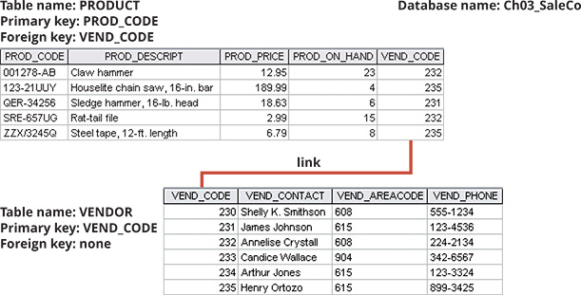
Types of Keys (3 of 3)
Figure 3.2 An Example of a Simple Relational Database

Slide 12
Knowledge Check Activity 3-1
What is the difference between a database and a table?

Slide 13
Knowledge Check Activity 3-1: Answer
What is the difference between a database and a table?
Answer: A table, a logical structure that represents an entity set, is only one of the components of a database. A table stores the end-user data.
The database is a structure that houses one or more tables and metadata. The metadata are data about data. Metadata include the data (attribute) characteristics and the relationships between the entity sets.

Slide 14
Integrity Rules (1 of 2)
Table 3.4 | Integrity Rules
Entity Integrity | Description
Requirement | All primary key entries are unique, and no part of a primary key may be null.
Purpose | Each row will have a known, unique identity, and foreign key values can properly reference primary key values.
Example | No invoice can have a duplicate number, nor can it be null; in short, all invoices are uniquely identified by their invoice number.
Referential Integrity | Description
Requirement | A foreign key may have either a null entry, as long as it’s not part of its table’s primary key, or an entry that matches the primary key value in a table to which it is related (every non-null foreign key value must reference an existing primary key value).
Purpose | The purpose is to ensure that every reference by a foreign key is a valid reference to the related primary key. It is possible for an attribute not to have a corresponding value, but it will be impossible to have an invalid entry; the enforcement of the referential integrity rule makes it impossible to delete a row in one table whose primary key has mandatory matching foreign key values in another table.
Example | A customer might not yet have an assigned sales representative (number), but it will be impossible to have an invalid sales representative (number).

Slide 15
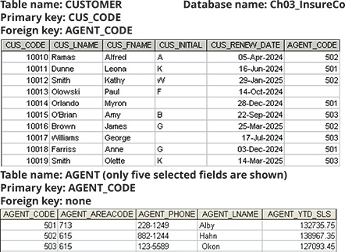
Integrity Rules (2 of 2)
Figure 3.3 An Illustration of Integrity Rules

Slide 16
Relational Algebra
Relational algebra is a set of mathematical principles that form the basis for manipulating relational table contents
The following are the eight main functions:
  SELECT, PROJECT, JOIN, INTERSECT, UNION, DIFFERENCE, PRODUCT, and DIVIDE

Slide 17
Formal Definitions and Terminology
A relation is the data that you see in your tables
A relvar is a variable that holds a relation
  It is a container (variable) for holding a relation data, not the relation itself
  The term is short for relation variable
A relvar has the following two parts:
  The heading contains the names of the attributes
  The body contains the relation

Slide 18
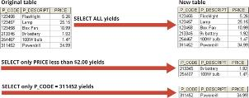
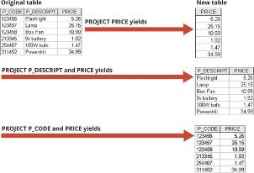
Relational Set Operators (1 of 7)
Figure 3.4 SELECT
SELECT is an operator used to select a subset of rows
Also known as RESTRICT
Figure 3.5 PROJECT
PROJECT is an operator used to select a subset of columns

Slide 19


Relational Set Operators (2 of 7)
Figure 3.6 UNION
UNION is an operator used to merge two tables into a new table, dropping duplicate rows
The tables must be union-compatible
Figure 3.7 INTERSECT
INTERSECT is an operator used to yield only the rows that are common to two union-compatible tables

Slide 20

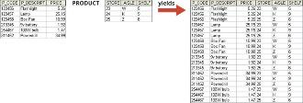
Relational Set Operators (3 of 7)
Figure 3.8 DIFFERENCE
DIFFERENCE is an operator used to yield all rows from one table that are not found in another union-compatible table
Figure 3.9 PRODUCT
PRODUCT is an operator used to yield all possible pairs of rows from two tables
Also known as the Cartesian product

Slide 21

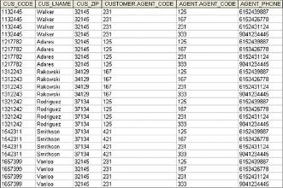
Relational Set Operators (4 of 7)
Figure 3.10 Two Tables that Will be Used in JOIN Illustrations
JOIN allows information to be intelligently combined from two or more tables
Figure 3.11 Natural JOIN, Step 1: PRODUCT
A natural join links tables by selecting only the rows with common values in their common attribute(s)

Slide 22


Relational Set Operators (5 of 7)
Figure 3.12 Natural JOIN, Step 2: SELECT
A SELECT is performed on the output of Step 1 to yield only the rows for which the AGENT_CODE values are equal
Figure 3.13 Natural JOIN, Step 3: PROJECT
A PROJECT is performed on the results of Step 2 to yield a single copy of each attribute

Slide 23
Relational Set Operators (6 of 7)
Other forms of JOIN include the following:
  Equijoin – links tables on the basis of an equality condition that compares specified columns of each table
  Theta join – links tables using an inequality comparison operator
  Inner join – only returns matched records from the tables that are being joined
  Outer join – matched pairs are retained and unmatched values in the other table are left null
    Left outer join: yields all of the rows in the first table, including those that do not have a matching value in the second table
    Right outer join: yields all of the rows in the second table, including those that do not have matching values in the first table

Slide 24
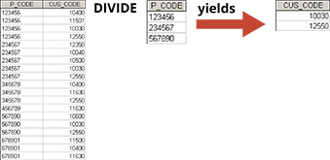
Relational Set Operators (7 of 7)
Figure 3.16 DIVIDE
The DIVIDE operator is used to answer questions about one set of data being associated with all values of data in another set of data

Slide 25
Knowledge Check Activity 3-2
Which relational algebra operators can be applied to a pair of tables that are not union-compatible?

Slide 26
Knowledge Check Activity 3-2: Answer
Which relational algebra operators can be applied to a pair of tables that are not union-compatible?
Answer: The Product, Join, and Divide operators can be applied to a pair of tables that are not union-compatible. Divide does place specific requirements on the tables to be operated on; however, those requirements do not include union-compatibility. Select (or Restrict) and Project are performed on individual tables, not pairs of tables. (Note that if two tables are joined, then the result is a single table and the Select or Project operator is performed on that single table.)

Slide 27
The Data Dictionary and the System Catalog
The data dictionary provides a detailed description of all tables in the database created by the user and designer
  It is sometimes described as “the database designer’s database” because it records the design decisions about tables and their structures
The system catalog is a detailed system data dictionary that describes all objects within the database
Homonyms and synonyms must be avoided to lessen confusion
    Homonym – same name is used to label different attributes
    Synonym – different names are used to describe the same attribute

Slide 28
Relationships within the Relational Database (1 of 6)
The one-to-many (1:M) relationship is the norm for relational databases
In the one-to-one (1:1) relationship, one entity can be related to only one other entity and vice versa
The many-to-many (M:N) relationship can be implemented by creating a new entity in 1:M relationships with the original entities
  A composite entity (i.e., bridge or associative entity) helps avoid problems inherent to M:N relationships
    It includes the primary keys of tables to be linked

Slide 29

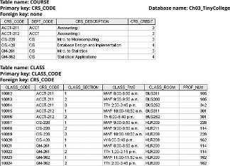
Relationships within the Relational Database (2 of 6)
Figure 3.19 The 1:M Relationship between COURSE and CLASS
Figure 3.20 The Implemented 1:M Relationship between COURSE and CLASS

Slide 30

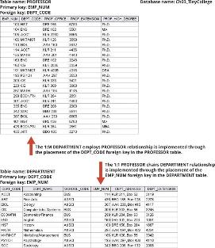
Relationships within the Relational Database (3 of 6)
Figure 3.21 The 1:1 Relationship between PROFESSOR and DEPARTMENT
Figure 3.22 The Implemented 1:1 Relationship between PROFESSOR and DEPARTMENT

Slide 31

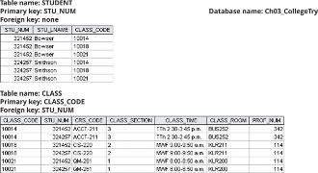
Relationships within the Relational Database (4 of 6)
Figure 3.23 The ERM’s M:N Relationship between STUDENT and CLASS
Figure 3.24 The Wrong Implementation of the M:N Relationship between STUDENT and CLASS

Slide 32
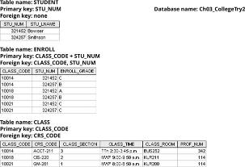
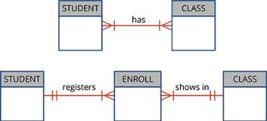
Relationships within the Relational Database (5 of 6)
Figure 3.25 Converting the M:N Relationship into Two 1:M Relationships
Because the ENROLL table links two tables, it is also called a linking table
Figure 3.26 Changing the M:N Relationships to Two 1:M Relationships

Slide 33
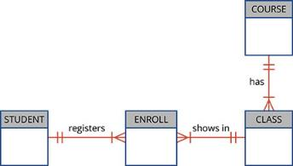
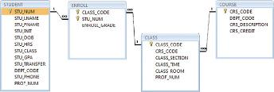
Relationships within the Relational Database (6 of 6)
Figure 3.27 The Expanded ER Model
Figure 3.28 The Relational Diagram for the Ch03_TinyCollege Database

Slide 34
Data Redundancy Revisited (1 of 2)
The relational database facilitates control of data redundancies through use of foreign keys
  Recall that foreign keys are common attributes that are shared by tables
Data redundancy should be controlled except in the following circumstances:
  Sometimes data redundancy must be increased to make the database serve crucial information purposes
  Sometimes data redundancy exists to preserve the historical accuracy of data

Slide 35
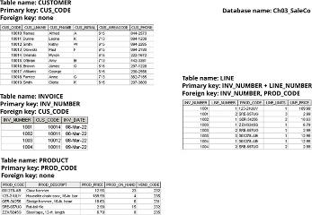

Data Redundancy Revisited (2 of 2)
Figure 3.29 A Small Invoicing System
Figure 3.30 The Relational Diagram for the Invoicing System

Slide 36
Indexes (1 of 2)
An index is an orderly arrangement to logically access rows in a table
The index key is the index’s reference point that leads to data location identified by the key
In a unique index, the index key can have only one pointer value associated with it
A table can have many indexes, but each index is associated with only one table
The index key can have multiple attributes

Slide 37
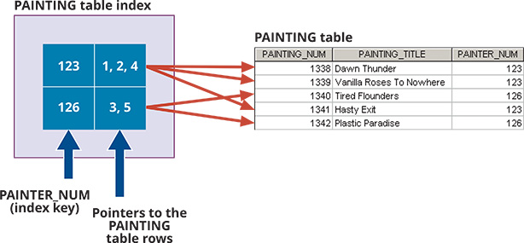
Indexes (2 of 2)
Figure 3.31 Components of an Index

Slide 38
Cobb’s Relational Database Rules (1 of 2)
Table 13.8 | Dr. Codd’s 12 Relational Database Rules
Rule | Rule Name | Description
1 | Information | All information in a relational database must be logically represented as column values in rows within tables.
2 | Guaranteed access | Every value in a table is guaranteed to be accessible through a combination of table name, primary key value, and column name.
3 | Systematic treatment of nulls | Nulls must be represented and treated in a systematic way, independent of data type.
4 | Dynamic online catalog based on the relational model | The metadata must be stored and managed as ordinary data—that is, in tables within the database; such data must be available to authorized users using the standard database relational language.
5 | Comprehensive data sublanguage | The relational database may support many languages; however, it must support one well-defined, declarative language as well as data definition, view definition, data manipulation (interactive and by program), integrity constraints, authorization, and transaction management (begin, commit, and rollback).
6 | View updating | Any view that is theoretically updatable must be updatable through the system.
7 | High-level insert, update, and delete | The database must support set-level inserts, updates, and deletes.

Slide 39
Cobb’s Relational Database Rules (2 of 2)
Table 13.8 | Dr. Codd’s 12 Relational Database Rules
Rule | Rule Name | Description
8 | Physical data independence | Application programs and ad hoc facilities are logically unaffected when physical access methods or storage structures are changed.
9 | Logical data independence | Application programs and ad hoc facilities are logically unaffected when changes are made to the table structures that preserve the original table values (changing order of columns or inserting columns).
10 | Integrity independence | All relational integrity constraints must be definable in the relational language and stored in the system catalog, not at the application level.
11 | Distribution independence | The end users and application programs are unaware of and unaffected by the data location (distributed vs. local databases).
12 | Nonsubversion | If the system supports low-level access to the data, users must not be allowed to bypass the integrity rules of the database.
13 | Rule zero | All preceding rules are based on the notion that to be considered relational, a database must use its relational facilities exclusively for management.

Slide 40
Knowledge Check Activity 3-3
Explain why the data dictionary is sometimes called "the database designer's database."

Slide 41
Knowledge Check Activity 3-3: Answer
Explain why the data dictionary is sometimes called "the database designer's database."
Answer: Just as the database stores data that is of interest to the users regarding the objects in their environment that are important to them, the data dictionary stores data that is of interest to the database designer about the important decisions that were made in regard to the database structure. The data dictionary contains the number of tables that were created, the names of all of those tables, the attributes in each table, the relationships between the tables, the data type of each attribute, the enforced domains of the attributes, etc.

Slide 42
Summary (1 of 2)
Now that the lesson has ended, you should be able to:
Describe the relational database model’s logical structure
Identify the relational model’s basic components and explain the structure, contents, and characteristics of a relational table
Use relational database operators to manipulate relational table contents
Explain the purpose and components of the data dictionary and system catalog
Identify appropriate entities and then the relationships among the entities in the relational database model

Slide 43
Summary (2 of 2)
Now that the lesson has ended, you should be able to (continued):
Describe how data redundancy is handled in the relational database model
Explain the purpose of indexing in a relational database

