Slide 1

Database Systems: Design, Implementation, and Management, 14e
Module 8: Advanced SQL
Coronel, Carlos and Morris, Steven, Database Systems: Design, Implementation, and Management, 14 Edition. © 2023 Cengage. All Rights Reserved. May not be scanned, copied or duplicated, or posted to a publicly accessible website, in whole or in part.

Slide 2
Chapter Objectives
By the end of this chapter, you should be able to:
Use SQL to create a table manually
Use SQL to create a copy of a table using a subquery
Manipulate the structure of tables to add, modify, and remove columns and constraints
Use SQL to do data manipulation (insert, update, and delete rows of data)
Use SQL to create database views, including updatable views
Use procedural SQL to create triggers, stored procedures, and procedural SQL functions
Create embedded SQL

Slide 3
Data Definition Commands (1 of 6)
Starting database model
  Refer to Figure 8.1 on the following slide
Creating the Database
  Before a new RDBMS can be used, the database structure and the tables that will hold the end-user data must be created
The Database Schema
  A schema is a logical group of database objects—such as tables and indexes—that are related to each other

Slide 4
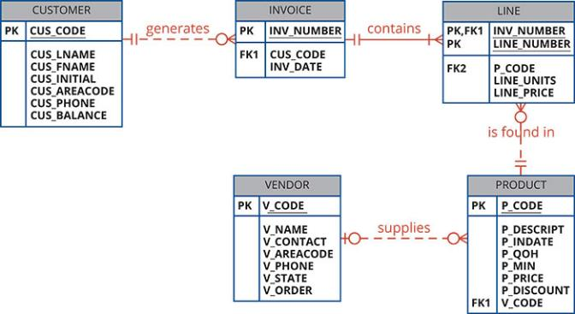
Data Definition Commands (2 of 6)
Figure 8.1 Database Model

Slide 5
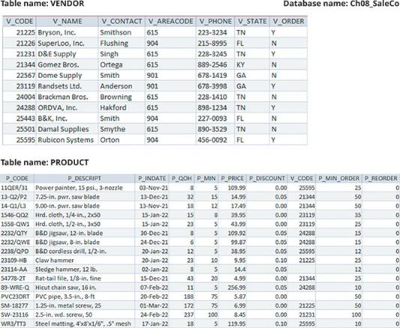
Data Definition Commands (3 of 6)
Figure 8.2 Vendor and Product Tables

Slide 6
Data Definition Commands (4 of 4)
Table 8.1 |  | Some Common SQL Data Types
Data Type | Format | Comments
Numeric | NUMERIC(L,D) or NUMBER (L,D) | The declaration NUMERIC(7,2) or NUMBER (7,2) indicates that numbers will be stored with two decimal places and may be up to seven digits long, including the sign and the decimal place (for example, 12.32 or −134.99).
 | INTEGER | May be abbreviated as INT. Integers are (whole) counting numbers, so they cannot be used if you want to store numbers that require decimal places.
 | SMALLINT | Like INTEGER but limited to integer values up to six digits. If your integer values are relatively small, use SMALLINT instead of INT.
 | DECIMAL(L,D) | Like the NUMERIC specification, but the storage length is a minimum specification. That is, greater lengths are acceptable, but smaller ones are not. DECIMAL(9,2), DECIMAL(9), and DECIMAL are all acceptable. In most popular DBMSs, this difference is not implemented so NUMERIC and DECIMAL operate the same.
Character | CHAR(L) | Fixed-length character data for up to 255 characters. If you store strings that are not as long as the CHAR parameter value, the remaining spaces are left unused. Therefore, if you specify CHAR(25), strings such as Smith and Katzenjammer are each stored as 25 characters. However, a U.S. area code is always three digits long, so CHAR(3) would be appropriate if you wanted to store such codes.
 | VARCHAR(L) or VARCHAR2(L) | Variable-length character data. The designation VARCHAR(25) or VARCHAR2(25) will let you store up to 25 characters. However, unlike CHAR, VARCHAR will not leave unused spaces. Oracle automatically converts VARCHAR to VARCHAR2.
Date | DATE | Stores dates in the Julian date format.

Slide 7
Creating Table Structures (1 of 3)
CREATE TABLE command
  CREATE TABLE is an SQL command that creates a table’s structures using the characteristics and attributes given
  The following is the syntax to use in order to implement a table structure
    CREATE TABLE tablename (
    column1 data type [constraint] [,
    column2 data type [constraint] ] [,
    PRIMARY KEY (column1 [, column2]) ] [,
    FOREIGN KEY (column1 [, column2]) REFERENCES tablename] [,
    CONSTRAINT constraint ] );

Slide 8
Creating Table Structures (2 of 3)
SQL Constraints
  The FOREIGN KEY constraint ensures that you cannot delete a vendor from the VENDOR table if at least one product row references that vendor
  The NOT NULL constraint ensures that a column does not accept nulls
  The UNIQUE constraint ensures that all values in a column are unique
  The DEFAULT constraint assigns a value to an attribute when a new row is added to a table
  The CHECK constraint is used to validate data when an attribute value is entered

Slide 9
Creating Table Structures (3 of 3)
Create a Table with a SELECT Statement
  SQL provides a way to rapidly create a new table based on selected columns and rows of an existing table using a subquery
  All of the data rows returned by the SELECT statement are copied automatically
SQL Indexes
  CREATE INDEX improves the efficiency of searches and avoids duplicate column values
  DROP INDEX is an SQL command used to delete database objects such as tables, views, indexes, and users

Slide 10
Knowledge Check Activity 8-1
What is the purpose of a CHECK constraint?

Slide 11
Knowledge Check Activity 8-1: Answer
What is the purpose of a CHECK constraint?
Answer: A CHECK constraint is used to limit the values that can appear in an attribute. It performs the function of enforcing a domain.

Slide 12
Altering Table Structures (1 of 4)
All changes in the table structure are made by using the ALTER TABLE command followed by a keyword that produces the specific change you want to make
  The following three options are available: ADD, MODIFY, and DROP
Changing a Column’s Data Type
  ALTER can be used to change a data type
Changing a Column’s Data Characteristics
  If the column to be changed already contains data, you can make changes in the column’s characteristics if those changes do not alter the data type

Slide 13
Altering Table Structures (2 of 4)
Adding a Column
  You can alter an existing table by adding one or more columns
  Be careful not to include the NOT NULL clause for the new column

Slide 14
Altering Table Structures (3 of 4)
Adding Primary Key, Foreign Key, and Check Constraints
  Primary key syntax is as follows:
  ALTER TABLE PART
  ADD PRIMARY KEY (PART_CODE);
  Foreign key syntax is as follows:
  ALTER TABLE PART
  ADD FOREIGN KEY (V_CODE) REFERENCES VENDOR;
  Check constraint syntax is as follows:
        ALTER TABLE PART
        ADD CHECK (PART_PRICE >= 0);

Slide 15
Altering Table Structures (4 of 4)
Dropping a Column
  The following is the syntax:
  ALTER TABLE VENDOR
  DROP COLUMN V_ORDER;
Deleting a Table From the Database
  DROP TABLE is an SQL command used to remove database tables
  The following is the syntax:
  DROP TABLE PART;

Slide 16
Data Manipulation Commands (1 of 4)
Adding Table Rows
  INSERT is a SQL command that allows the insertion of one or more data rows into a table using a subquery
  INSERT command syntax:
  INSERT INTO tablename VALUES (value1, value2, …, valuen)
  To inserting rows with null attributes, use a NULL entry
  When inserting rows with optional attributes, you can indicate attributes that have required values

Slide 17
Data Manipulation Commands (2 of 4)
Inserting Table Rows with a SELECT Subquery
  Using a subquery with the INSERT command, it is possible to add multiple rows to a table, using another table as the source, at the same time
  Use the following SELECT syntax:
  INSERT INTO target_tablename[(target_columnlist)]
  SELECT source_columnlist
  FROM source_tablename;
Saving Table Changes
  The syntax for the COMMIT command is:
  COMMIT [WORK | TRANSACTION]

Slide 18
Data Manipulation Commands (3 of 4)
Updating Table Rows
  UPDATE command is used to modify data in a table
  The syntax for the UPDATE command is as follows:
  UPDATE tablename
  SET columnname = expression [, columnname = expression]
  [WHERE conditionlist ];

Slide 19
Data Manipulation Commands (4 of 4)
Deleting Table Rows
  The following is the DELETE statement syntax:
  DELETE FROM tablename
  [WHERE conditionlist ];
Restoring Table Contents
  The ROLLBACK command is used to restore the database table contents to the condition that existed after the last COMMIT statements
  ROLLBACK;

Slide 20
Virtual Tables: Creating a View (1 of 2)
A view is a virtual table based on a SELECT query that is saved as an object in the database
A base table is the table on which a view is based
CREATE VIEW is a SQL command that creates a logical, “virtual” table
  The view can be treated as a real table
  The following is the CREATE VIEW syntax:
  CREATE VIEW viewname AS SELECT query

Slide 21
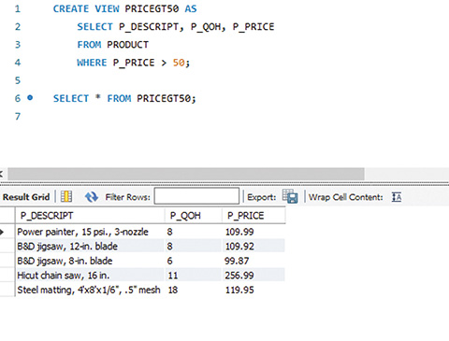
Virtual Tables: Creating a View (2 of 2)
Figure 8.5 Creating a Virtual Table with the Create View command

Slide 22
Updatable Views
One of the most common operations in production database environments is to use batch update routines to update a master table attribute with transaction data
A batch update routine is a routine that pools multiple transactions into a single batch to update a master table in a single operation
A view that can update attributes in base tables that are used in the view is known as an updatable view
The following are the most common updatable view restrictions:
  GROUP BY expressions or aggregate functions cannot be used
  Set operators cannot be used
  Most restrictions are based on the use of JOINs or group operators in views

Slide 23
Knowledge Check Activity 8-2
What is the difference between an INSERT command and an UPDATE command?

Slide 24
Knowledge Check Activity 8-2: Answer
What is the difference between an INSERT command and an UPDATE command?
Answer: The INSERT command is used to add a new row to a table. The UPDATE command changes the values in attributes of an existing row. UPDATE will not increase the number of rows in a table, but INSERT will.

Slide 25
Auto Increment, Identity, and Sequences (1 of 3)
MySQL uses the AUTO_INCREMENT property during table creation to indicate that values for an attribute should be generated in the same fashion
  Similar to IDENTITY columns, only one column in a table can have AUTO_INCREMENT specified, and that column must also be defined as the primary key of the table
A sequence is an object for generating unique segment values for a field
In recent years, Oracle added support for Identity columns and MS SQL Server added support for sequences

Slide 26
Auto Increment, Identity, and Sequences (2 of 3)
The following are similarities in the use of sequences across multiple DBMSs
  Sequences are an independent object in the database
  Sequences have a name and can be used anywhere a value expected
  Sequences are not tied to a table or a column
  Sequences generate a numeric value that can be assigned to any column in any table
  The table attribute with an assigned value can be edited and modified

Slide 27
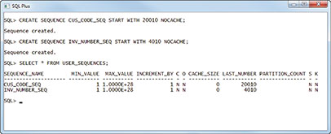
Auto Increment, Identity, and Sequences (3 of 3)
Figure 8.7 Oracle Sequence

Slide 28
Procedural SQL
Persistent stored module (PSM) is a block of code that contains standard SQL statements and procedural extensions that is stored and executed at the DBMS server
Procedural SQL is an extension of SQL that adds procedural programming capabilities, such as variables and logical flow control, to SQL and is designed to run inside the database
  The procedural code is executed as a unit by the DBMS when it is invoked by the end user
End users can use procedural SQL to create the following:
  Stored procedures
  Triggers
  Procedural SQL functions

Slide 29
Stored Procedures
A stored procedure is a named collection of procedural and SQL statements
  They are stored in the database
  A major advantage of stored procedures is that they can be used to encapsulate and represent business transactions
Using stored procedures offers the following advantages:
  Stored procedures substantially reduce network traffic and increase performance
  Stored procedures help reduce code duplication by means of code isolation and code sharing

Slide 30
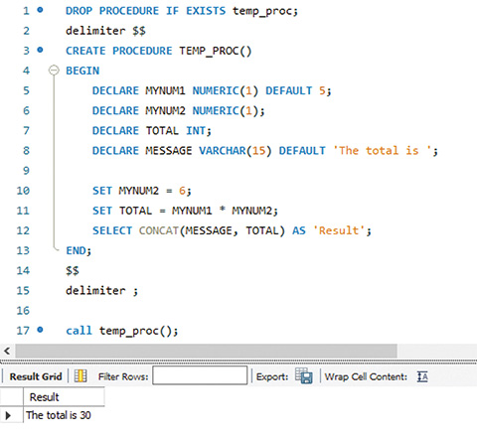
Working with Variables
Figure 8.11 Variable Manipulation

Slide 31
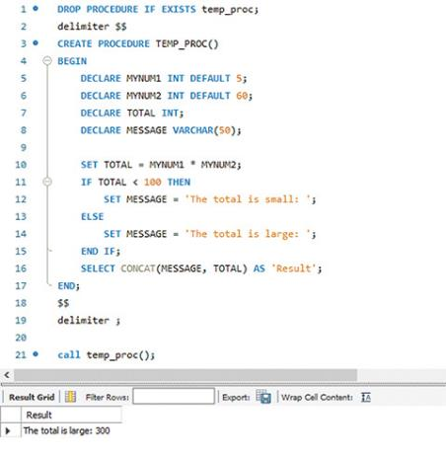
Conditional Execution
Figure 8.12 Conditional Execution

Slide 32
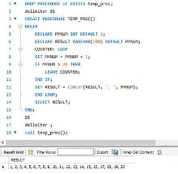
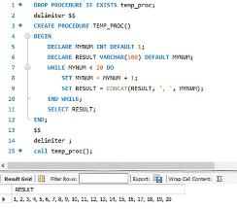
Iteration or Looping
Figure 8.14 A Simple Loop
Figure 8.15 Implementation of a WHILE Loop

Slide 33
Select Processing with Cursors (1 of 2)
A cursor is a special construct used to hold data rows returned by a SQL query
  An implicit cursor is automatically created when the SQL statement returns only one row
  An explicit cursor holds the output of a SQL statement that may return two or more rows but could return zero or only one row
  To create an explicit cursor, you use the following syntax:
  DECLARE cursor_name CURSOR FOR select-query;
Cursor-style processing involves retrieving data from the cursor one row at a time
  When you fetch a row from the cursor, the data from the “current” row in the cursor is copied to the PL/SQL variables

Slide 34
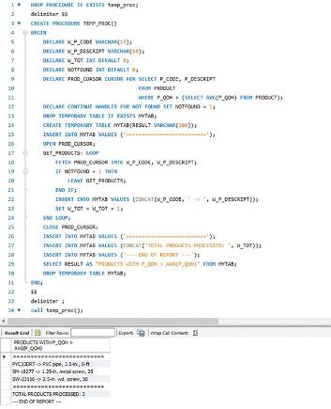
Select Processing with Cursors (2 of 2)
Figure 8.19 An Explicit Cursor Example

Slide 35
Stored Procedures with Parameters (1 of 2)
One of the most valuable features of working with stored procedures is their ability to use parameters
A parameter is a value that is provided to the program at the time of execution
Figure 8.21 shows the code necessary to pass an argument, or parameter, to represent a rate of increase to the procedure

Slide 36
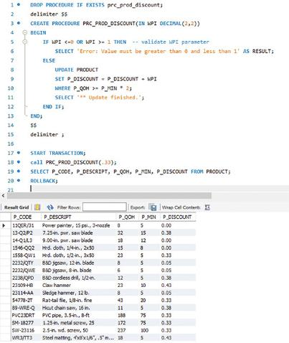
Stored Procedures with Parameters (2 of 2)
Figure 8.21 Second Version of the PRC_PROD_DISCOUNT Stored Procedure

Slide 37
Triggers (1 of 2)
A trigger is a procedural SQL code automatically invoked by the relational database management system when a data manipulation event occurs
It is useful to remember the following:
  A trigger is invoked before or after a data row is inserted, updated, or deleted
  A trigger is associated with a database table
  Each database table may have one or more triggers
  A trigger is executed as part of the transaction that triggered it
  Triggers are critical to proper database operation and management

Slide 38
Triggers (2 of 2)
A trigger definition contains the following parts:
  The triggering timing: indicates when the trigger’s code executes
  The triggering statement or triggering event: the statement that causes the trigger to execute
  The triggering level:
    A statement-level trigger is executed once and a row-level trigger requires use of the FOR EACH ROW keywords
  The triggering action: the SQL and procedural SQL code enclosed between the BEGIN and END keywords

Slide 39
User Defined Functions
A user defined function (UDF) is basically a named group of procedural and SQL statements that returns a value, as indicated by a RETURN statement in its program code
To create a function, you use the following syntax:
  CREATE FUNCTION function_name (IN argument data-type, …) RETURNS data-type
  BEGIN
    Procedure SQL statements;
    …
    RETURN (value or expression);
  END;

Slide 40
Embedded SQL (1 of 4)
Embedded SQL are SQL statements contained within an application programming language
A host language is any language that contains embedded SQL statements
Differences between SQL and procedural languages include the following
  Run-time mismatch:
    With SQL, each instruction is parsed and it is executed one instruction at a time
    The Host program typically runs at the client side in its own memory space

Slide 41
Embedded SQL (2 of 4)
Differences between SQL and procedural languages (continued)
  Processing mismatch
    Conventional programming languages process one data element at a time
    Newer programming environments manipulate data sets in a cohesive manner
  Data type mismatch
    Data types provided by SQL might not match data types used in different host languages

Slide 42
Embedded SQL (3 of 4)
The embedded SQL framework defines the following:
  A standard syntax to identify embedded SQL code within the host language
  A standard syntax to identify host variables
  A communication area used to exchange status and error information between SQL and the host language

Slide 43
Embedded SQL (4 of 4)
Static SQL is a style of embedded SQL I which the SQL statements do not change while the application is running
Dynamic SQL is term used to describe an environment in which the SQL statement is generated at run time
  In a dynamic SQL environment, a program can generate the SQL statements that are required to respond to ad hoc queries

Slide 44
Knowledge Check Activity 8-3
What is a stored procedure, and why is it particularly useful?

Slide 45
Knowledge Check Activity 8-3: Answer
What is a stored procedure, and why is it particularly useful?
Answer: A stored procedure is a named block of Procedural SQL and standard SQL statements. One of the major advantages of stored procedures is that they can be used to encapsulate and represent business transactions.

Slide 46
Summary
Now that the lesson has ended, you should be able to:
Use SQL to create a table manually
Use SQL to create a copy of a table using a subquery
Manipulate the structure of tables to add, modify, and remove columns and constraints
Use SQL to do data manipulation (insert, update, and delete rows of data)
Use SQL to create database views, including updatable views
Use procedural SQL to create triggers, stored procedures, and procedural SQL functions
Create embedded SQL

