Slide 1

Database Systems: Design, Implementation, and Management, 14e
Module 12: Distributed Database Management Systems
Coronel, Carlos and Morris, Steven, Database Systems: Design, Implementation, and Management, 14 Edition. © 2023 Cengage. All Rights Reserved. May not be scanned, copied or duplicated, or posted to a publicly accessible website, in whole or in part.

Slide 2
Chapter Objectives
By the end of this chapter, you should be able to:
Explain the purpose and function of distributed database management systems (DDBMSs)
Summarize the advantages and disadvantages of DDBMSs
Describe the characteristics and components of DDBMSs
Explain how database implementation is affected by levels of data and process distribution
Describe how transactions are managed in a distributed database environment
Describe how distributed database design balances performance, scalability, and availability
Explain the trade-offs of implementing a distributed data system

Slide 3
The Evolution of Distributed Database Management Systems (1 of 7)
A distributed database management system (DDBMS) governs storage and processing of logically related data over interconnected computer systems
  Data and processing functions are distributed among several sites
The use of a centralized database management system required corporate data be stored in a single central site
  Data access was provided through dumb terminals
  The centralized approach filled the structured information needs of corporations; but it fell short when quickly moving events required faster response times and equally quick access to information

Slide 4
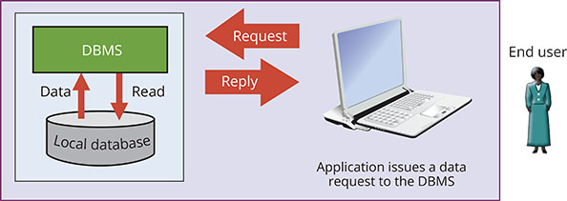
The Evolution of Distributed Database Management Systems (2 of 7)
Figure 12.1 Centralized Database Management System

Slide 5
The Evolution of Distributed Database Management Systems (3 of 7)
The following are changes that affected the nature of systems:
  Globalization of business operation
  Customer demands and market needs for an on-demand transaction style, based on web-based services
  Rapid social and technological changes fueled by low-cost, smart mobile devices
  Converging data realms in the digital world
  The advent of social media to reach new customers and markets

Slide 6
The Evolution of Distributed Database Management Systems (4 of 7)
Database requirements in a dynamic business environment include the following:
  Rapid ad hoc data access became crucial in the quick-response decision-making environment
  Distributed data access was needed to support geographically dispersed business units
The following are factors that influenced the DDBMS:
  Acceptance of the Internet as a platform for business
  Mobile wireless revolution
  Growth of use of “application as a service”
  Focus on mobile business intelligence and an emphasis on Big Data analytics

Slide 7
The Evolution of Distributed Database Management Systems (5 of 7)
The distributed database is especially desirable because centralized DBM is subject to problems such as:
  Performance degradation
  High costs
  Reliability problems
  Scalability problems
  Organizational rigidity

Slide 8
The Evolution of Distributed Database Management Systems (6 of 6)
Table 12.1 | Distributed DBMS Advantages and Disadvantages
Advantages | Disadvantages
Data is located near the site of greatest demand | Complexity of management and control
Faster data access | Technological difficulty
Faster data processing | Security
Growth facilitation | Lack of standards
Improved communications | Increased storage and infrastructure requirements
Reduced operating costs | Increased training cost
User-friendly interface | Higher costs
Less danger of a single-point failure
Processor independence

Slide 9
Distributed Processing and Distributed Databases (1 of 2)
In distributed processing, a database’s logical processing is shared among two or more physically independent sites via network
A distributed database stores a logically related database over two or more physically independent sites via a computer network
A database fragments is a subset of a distributed database composed of many parts in distributed database system
  Database fragments are located at different sites and can be replicated among various sites

Slide 10
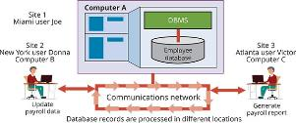
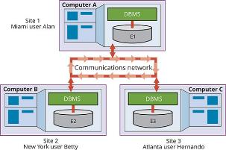
Distributed Processing and Distributed Databases (2 of 2)
Figure 12.2 Distributed Processing Environment
Figure 12.3 Distributed Database Environment

Slide 11
Characteristics of Distributed Database Management Systems (1 of 4)
A DBMS must have at least the following functions to be classified as distributed:
  Application interface
  Validation
  Transformation
  Query optimization
  Mapping
  I/O interface
  Formatting

Slide 12
Characteristics of Distributed Database Management Systems (2 of 4)
A DBMS must have at least the following functions to be classified as distributed (continued):
  Security
  Backup and recovery
  DB administration features
  Concurrency control
  Transaction management

Slide 13
Characteristics of Distributed Database Management Systems (3 of 4)
A fully distributed DBMS must perform all of the following functions:
  Receive the request of an application or end user
  Validate, analyze, and decompose the request
  Map the request’s logical-to-physical data components
  Decompose request into several I/O operations
  Search, locate, read and validate data
  Ensure database consistency, security, and integrity
  Validate data for conditions specified by request
  Present data in required format

Slide 14
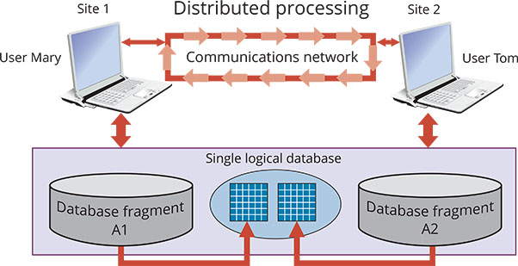
Characteristics of Distributed Database Management Systems (4 of 4)
Figure 12.4 A Fully Distributed Database Management System

Slide 15
DDBMS Components (1 of 2)
The DDBMS must include at least the following components:
  Computer workstations or remote devices
  Network hardware and software components
  Communications media
  Transaction processor (TP) – the software component found in each computer or device that requests data (also known as the application processor or the transaction manager)
  Data processor (DP) or data manager (DM) – the software component residing on each computer or device that stores and retrieves data located at the site

Slide 16
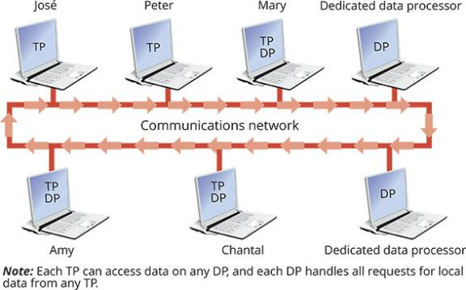
DDBMS Components (2 of 2)
Figure 12.5 Distributed Database System Components

Slide 17
Knowledge Check Activity 12-1
What are the advantages of the DDBMS?

Slide 18
Knowledge Check Activity 12-1: Answer
What are the advantages of the DDBMS?
Answer:
  Data is located near the site of the greatest demand
  Faster data access
  Faster data processing
  Improved communications
  Reduced operating costs
  User-friendly interface
  Less danger of a single-point failure
  Processor independence

Slide 19
Levels of Data and Process Distribution
Database Systems: Levels of Data and Process Distribution
Table 12.2
Advantages | Single-Site Data | Multiple-Site Data
Single-site process | Host DBMS | Not applicable (Requires multiple processes)
Multiple-site process | File Server Client/server DBMS (LAN DBMS) | Fully distributed Client/server DDBMS

Slide 20
Single-Site Processing, Single-Site Data (1 of 2)
In the single-site processing, single-site data (SPSD) scenario, all processing is done on a single host computer
  All data is stored on the host computer’s local disk
Processing cannot be done on the end user’s side of the system
The DBMS is accessed by terminals connected to the host computer

Slide 21
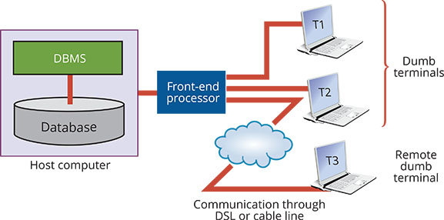
Single-Site Processing, Single-Site Data (2 of 2)
Figure 12.6 Single-Site Processing, Single-Site Data (Centralized)

Slide 22
Multiple-Site Processing, Single-Site Data (1 of 2)
Under the multiple-site processing, single-site data (MPSD) scenario, multiple processes run on different computers that share a single data repository
  Typically, MPSD requires a network file server running conventional applications that are accessed through a network
Client/server architecture is similar to that of the network file server except that all database processing is done at the server site, reducing network traffic
  Reduces network traffic
Client/server system’s processing is distributed
  This type of architecture is capable of supporting data at multiple sites

Slide 23
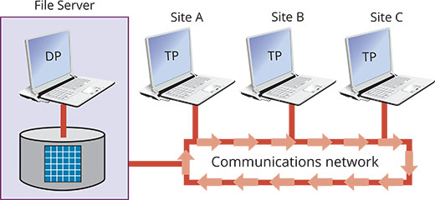
Multiple-Site Processing, Single-Site Data (2 of 2)
Figure 12.7 Multiple-Site Processing, Single-Site Data

Slide 24
Multiple-Site Processing, Multiple-Site Data (1 of 2)
The multiple-site processing multiple-site data (MPMD) scenario describes a fully distributed DBMS with support for multiple data processors and transaction processors at multiple sites
DDBMSs are classified as one of the following:
  Homogeneous DDBMSs integrate multiple instances of same DBMS over a network
  Heterogeneous DDBMSs integrate different types of DBMSs over a network
  A fully heterogeneous DDBMS support different DBMSs, each supporting different data model running under different computer systems

Slide 25
Multiple-Site Processing, Multiple-Site Data (2 of 2)
A DDBMS is subject to the following restrictions:
  Remote access is provided on a read-only basis and does not support write privileges
  Restrictions are placed on the number of remote tables that may be accessed in a single transaction
  Restrictions are placed on the number of distinct databases that may be accessed
  Restrictions are placed on the database model that may be accessed

Slide 26
Distributed Database Transparency Features
The minimum desirable DDBMS transparency features include the following:
  Distribution transparency allows a distributed database to be treated as a single logical DB
  Transaction transparency allows a transaction to update data at more than one network site
  Failure transparency ensures that the system will continue to operate in the event of a network failure
  Performance transparency allows the system to perform as if it were a centralized DBMS
  Heterogeneity transparency allows the integration of different local DBMSs under a common, or global, schema

Slide 27
Distribution Transparency (1 of 2)
Distribution transparency allows management of physically dispersed database as if centralized
Three levels of distribution transparency are recognized:
  Fragmentation transparency allows a system to treat a distributed database as a single database even through it is divided into two or more fragments
  Location transparency exists when the end user or programmer must specify the database fragment names but does not need to specify where those fragments are located
  Local mapping transparency exists when the end user or programmer must specify both the fragment names and their locations

Slide 28
Distribution Transparency (2 of 2)
The unique fragment condition indicates that each row is unique, regardless of the fragment in which it is located
Distribution transparency is supported by a distributed data dictionary (DDD) or distributed data catalog (DDC)
  The DDC contains the description of the entire database as seen by the database administrator
The distributed global schema is the common database schema to translate user requests into subqueries

Slide 29
Transaction Transparency
Transaction transparency is a DDBMS property that ensures database transactions will maintain the distributed database’s integrity and consistency
Transaction transparency ensures that the transaction will be completed only when all database sites involved complete their part of the transaction
Distributed database systems require complex mechanisms to manage transactions and ensure the database’s consistency and integrity

Slide 30
Distributed Requests and Distributed Transactions
A remote request lets a single SQL statement access the data processed by a single remote database processor
A remote transaction accesses data at single remote site
A distributed transaction is a database transaction that accesses data in several remote data processors (DPs) in a distributed database
A distributed request lets a single SQL statement reference data at several DP sites

Slide 31
Distributed Concurrency Control
Concurrency control is especially important in distributed databases environment
  Multi-site, multiple-process operations are more likely to create inconsistencies and deadlocked transactions
The solution to inconsistent database is a two-phase commit protocol

Slide 32
Two-Phase Commit Protocol
The two-phase commit protocol (2PC) guarantees that if a portion of a transaction operation cannot be committed, all changes made at the other sites will be undone
2PC requires each DP’s transaction log entry be written before the database fragment is updated
The DO-UNDO-REDO protocol is used by the DP to roll transactions back and forward with the help of the system’s transaction log entries
The write-ahead protocol forces the log entry to be written to permanent storage before actual operation takes place
Two-phase commit protocol defines operations between coordinator and one or more subordinates

Slide 33
Knowledge Check Activity 12-2
To which transparency feature are the query optimization functions related?

Slide 34
Knowledge Check Activity 12-2: Answer
To which transparency feature are the query optimization functions related?
Answer: Query‑optimization functions are associated with the performance transparency features of a DDBMS. In a DDBMS the query‑optimization routines are more complicated because the DDBMS must decide where and which fragment of the database to access. Data fragments are stored at several sites, and the data fragments are replicated at several sites.

Slide 35
Performance and Failure Transparency (1 of 2)
Performance transparency allows a DDBMS to perform as if it were a centralized database
Failure transparency ensures the system will operate in case of network failure
The objective of query optimization is to minimize total costs associated with the execution of a request
The costs associated with a request are a function of the following:
  Access time (I/O) cost involved in accessing data from multiple remote sites
  Communication costs associated with data transmission
  CPU time cost associated with the processing overhead of managing distributed transactions

Slide 36
Performance and Failure Transparency (2 of 2)
The following are considerations for resolving data requests in a distributed data environment:
  Data distribution and data replication
    Replica transparency refers to the DDBMS’s ability to hide multiple copies of data from the user
  Network and node availability
    Network latency is the delay imposed by the amount of time required for a data packet to make a round trip
    Network partitioning is the delay imposed when nodes become suddenly unavailable due to a network failure

Slide 37
Distributed Database Design
The design of a distributed database introduces three new issues:
  How to partition database into fragments
  Which fragments to replicate
  Where to locate those fragments and replicas

Slide 38
Data Fragmentation
Data fragmentation allows you to break a single object into two or more segments, or fragments
  Information about data fragmentation is stored in distributed data catalog (DDC)
Data fragmentation strategies include the following:
  Horizontal fragmentation refers to the division of a relation into subsets (fragments) of tuples (rows)
  Vertical fragmentation refers to the division of a relation into attribute (column) subsets
  Mixed fragmentation refers to a combination of horizontal and vertical strategies

Slide 39
Data Replication (1 of 2)
Data replication refers to the storage of data copies at multiple sites served by a computer network
Replicated data is subject to the mutual consistency rule, which requires all copies of data fragments be identical
The following are two styles of replication:
  Push replication focuses on maintaining data consistency
  Pull replication focuses on maintaining data availability and allows for temporary data inconsistencies

Slide 40
Data Replication (2 of 2)
Data replication scenarios include the following:
  A fully replicated database stores multiple copies of each database fragment at multiple sites
  A partially replicated database stores multiple copies of some database fragments at multiple sites
  An unreplicated database stores each database fragment at a single site

Slide 41
Data Allocation
Data allocation describes the process of deciding where to locate data
Data allocation strategies are as follows:
  With centralized data allocation, the entire database stored at one site
  With partitioned data allocation, the database is divided into two or more disjoined fragments and stored at two or more sites
  With replicated data allocation, copies of one or more database fragments are stored at several sites

Slide 42
The CAP Theorem
CAP stands for three desirable properties:
  Consistency
  Availability
  Partition tolerance
The trade-off between consistency and availability has generated a new type of system in which data is basically available, soft state, eventually consistent (BASE)
  BASE refers to a data consistency model in which data changes are not immediate but propagate slowly through the system until all replicas are consistent

Slide 43
C.J. Date’s 12 Commandments for
Distributed Databases
Table 12.9 |  | C.J. Date’s 12 Commandments for Distributed Databases
Rule Number | Rule Name | Rule Explanation
1 | Local-site independence | Each local site can act as an independent, autonomous, centralized DBMS.
2 | Central-site independence | No site in the network relies on a central site or any other site.
3 | Failure independence | The system is not affected by node failures.
4 | Location transparency | The user does not need to know the location of data to retrieve that data.
5 | Fragmentation transparency | Data fragmentation is transparent to the user, who sees only one logical database.
6 | Replication transparency | The user sees only one logical database
7 | Distributed query processing | A distributed query may be executed at several different DP sites.
8 | Distributed transaction processing | A transaction may update data at several different sites, and the transaction is executed transparently.
9 | Hardware independence | The system must run on any hardware platform.
10 | Operating system independence | The system must run on any operating system platform.
11 | Network independence | The system must run on any network platform.
12 | Database independence | The system must support any vendor’s database product.

Slide 44
Knowledge Check Activity 12-3
What are the two basic styles of data replication?

Slide 45
Knowledge Check Activity 12-3: Answer
What are the two basic styles of data replication?
Answer: There are basically two styles of replication:
  Push replication. In this case, the originating DP node sends the changes to the replica nodes to ensure that all data are mutually consistent.
  Pull replication. The originating DP node notifies the replica nodes so they can pull the updates one their own time.

Slide 46
Summary
Now that the lesson has ended, you should be able to:
Explain the purpose and function of distributed database management systems (DDBMSs)
Summarize the advantages and disadvantages of DDBMSs
Describe the characteristics and components of DDBMSs
Explain how database implementation is affected by levels of data and process distribution
Describe how transactions are managed in a distributed database environment
Describe how distributed database design balances performance, scalability, and availability
Explain the trade-offs of implementing a distributed data system

