Slide 1

Database Systems: Design, Implementation, and Management, 14e
Module 13: Business Intelligence and Data Warehouses
Coronel, Carlos and Morris, Steven, Database Systems: Design, Implementation, and Management, 14 Edition. © 2023 Cengage. All Rights Reserved. May not be scanned, copied or duplicated, or posted to a publicly accessible website, in whole or in part.

Slide 2
Chapter Objectives (1 of 2)
By the end of this chapter, you should be able to:
Describe the role of business intelligence in providing comprehensive business decision support
Describe the architecture, reporting styles, evolution, and benefits of business intelligence
Differentiate between operational data and decision support data
Identify the purpose, characteristics, and components of a data warehouse
Develop star and snowflake schemas for decision-making purposes

Slide 3
Chapter Objectives (2 of 2)
By the end of this chapter, you should be able to (continued):
Describe the characteristics and capabilities of online analytical processing (OLAP)
Describe the role and functions of data analytics and data mining
Explain how SQL analytic functions are used to support data analytics
Define data visualization and explain how it supports business intelligence
Define a data lake

Slide 4
The Need for Data Analysis
Organizations tend to grow and prosper as they gain a better understanding of their environment
  Managers need to evaluate how the business is doing through tracking daily transactions and analyzing company data
Organizations are always looking for a competitive advantage through product development, market positioning, sales promotions, and customer service
Companies and software vendors addressed these multilevel decision support needs by creating autonomous applications for particular groups of users
  This more comprehensive and integrated decision support framework within organizations became known as business intelligence

Slide 5
Business Intelligence (1 of 2)
Business intelligence (BI) is a term that describes a comprehensive, cohesive, integrated set of tools and processes used to capture, collect, integrate, store, and analyze data
  The purpose is to generate and present information to support business decision making
BI is a framework that allows transformation of the following:
  Data into information
  Information into knowledge
  Knowledge into wisdom

Slide 6
Business Intelligence (2 of 2)
BI provides a framework for the following:
  Collecting and storing operational data and aggregating it into decision support data
  Analyzing decision support data and presenting generated information to end users to support business decisions
  Making business decisions which generate more data
  Monitoring results to evaluate outcomes and predicting future outcomes with a high degree of accuracy

Slide 7
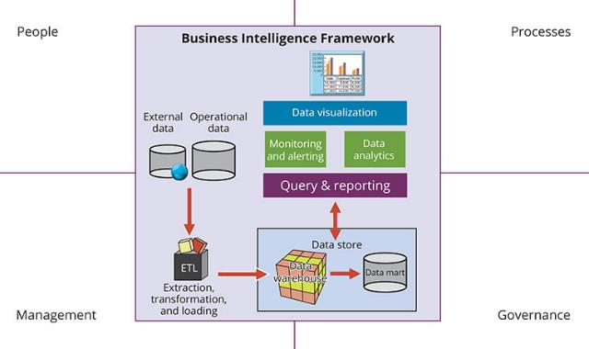
Business Intelligence Architecture (1 of 3)
Figure 13.1 Business Intelligence Framework

Slide 8
Business Intelligence Architecture (2 of 3)
Master data management (MDM) is a collection of concepts, techniques, and processes for identification, definition, and management of data elements
Governance is a method of government for controlling business health and for consistent decision making
Key performance indicators (KPI) are numeric or scale-based measurements that assess company’s effectiveness in reaching its goals
    General
    Finance
    Human resources
    Education

Slide 9
Business Intelligence Architecture (3 of 3)
A BI system’s advanced decision support functions come to life via its intuitive and informational user interface, and reporting capabilities
A modern BI system provides the following reporting styles:
  Advanced reporting
  Monitoring and alerting
  Advanced data analytics

Slide 10
Business Intelligence Benefits
Improved decision making is the main goal of BI, but BI also provides the following benefits:
  Integrating architecture
  Common user interface for data reporting and analysis
  Common data repository fosters single version of company data
  Improved organizational performance
Achieving all these benefits takes a lot of human, financial, technological resources, and time
  BI benefits are the result of a focused company-wide effort that could take a long time

Slide 11
Business Intelligence Evolution
A decision support system (DSS) is an arrangement of computerized tools used to assist managerial decision making
  A DSS typically has a much narrower focus and reach than a BI solution
BI information technology has evolved from centralized reporting styles to the current, mobile BI and Big Data analytics style in the span of just a few years
  The rate of technological change is not slowing down; technology advancements are accelerating the adoption of BI to new levels

Slide 12
Business Intelligence Technology Trends
The following technological advances are driving the growth of business intelligence technologies:
  Data storage improvements
  Business intelligence appliances
  Business intelligence as a service
  Big Data analytics
  Personal analytics

Slide 13
Knowledge Check Activity 13-1
What are decision support systems, and what role do they play in the business environment?

Slide 14
Knowledge Check Activity 13-1: Answer
What are decision support systems, and what role do they play in the business environment?
Answer: Decision Support Systems (DSS) are based on computerized tools that are used to enhance managerial decision-making. Because complex data and the proper analysis of such data are crucial to strategic and tactical decision making, DSS are essential to the well-being and even survival of businesses that must compete in a global market place.

Slide 15
Operational Data versus Decision Support Data (1 of 2)
Although BI is used at the strategic and tactical managerial levels within organizations, its effectiveness depends on the quality of data gathered at the operational level
  Operational data is seldom well suited to decision support tasks
Operational data is useful for capturing daily business transactions
Decision support data gives tactical and strategic business meaning to the operational data
Decision support data differs from operational data in three main areas
  Time span
  Granularity (level of aggregation)
  Dimensionality

Slide 16
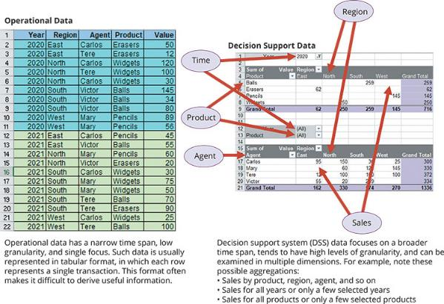
Operational Data versus Decision Support Data (2 of 2)
Figure 13.3 Transforming Operational Data into Decision Support Data

Slide 17
Decision Support Database Requirements
The decision support database schema must support complex, non-normalized data representations
  It must contain data that is aggregated and summarized and the queries must be able to extract multidimensional time slices
Data extraction capabilities should allow batch and scheduled data extraction and should support different data sources and check for inconsistent data or data validation rules
Database size – the DBMS must be capable of supporting very large databases (VLDBs)
  To support a VLDB, the DBMS might be required to support advanced storage technologies and multiple-processor technologies

Slide 18
The Data Warehouse (1 of 2)
The data warehouse is an integrated, subject-oriented, time-variant, nonvolatile collection of data that provides support for decision making
Components of the data warehouse include the following:
  Integrated
  Subject-oriented
  Time-variant
  Nonvolatile

Slide 19
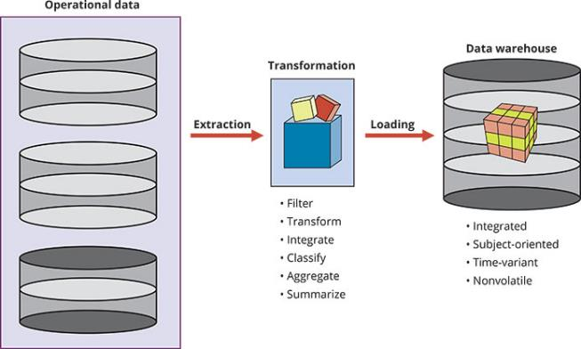
The Data Warehouse (2 of 2)
Figure 13.4 The ETL Process

Slide 20
Data Marts
A data mart is a small, single-subject data warehouse subset that provides decision support to a small group of people
Benefits of data marts over data warehouses include the following:
  Lower cost and shorter implementation time
  Technologically advanced
  Inevitable “people issues”

Slide 21
Twelve Rules That Define a Data Warehouse
Table 13.9 | Twelve Rules for a Data Warehouse
Rule No. | Description
1 | The data warehouse and operational environments are separated.
2 | The data warehouse data is integrated.
3 | The data warehouse contains historical data over a long time.
4 | The data warehouse data is snapshot data captured at a given point in time.
5 | The data warehouse data is subject oriented.
6 | The data warehouse data is mainly read-only with periodic batch updates from operational data.
7 | The data warehouse development life cycle differs from classical systems development.
8 | The data warehouse contains data with several levels of detail: current detail data, old detail data, lightly summarized data, and highly summarized data
9 | The data warehouse environment is characterized by read-only transactions to very large data sets.
10 | The data warehouse environment has a system that traces data sources, transformations, and storage.
11 | The data warehouse’s metadata is a critical component of this environment.
12 | The data warehouse contains a chargeback mechanism for resource usage that enforces optimal use of the data by end users.

Slide 22
Star Schemas (1 of 5)
The star schema is a data-modeling technique used to map multidimensional decision support data into a relational database
Basic star schema components include the following:
  Facts are numeric values that represent a specific business aspect
  Dimensions are qualifying characteristics that provide additional perspectives to a fact
  Attributes are used to search, filter, and classify facts
    Slice and dice is the ability to focus on slices of the data cube for more detailed analysis
  The attribute hierarchy provides a top-down data organization that is used for aggregation and drill-down/roll-up data analysis

Slide 23
Star Schemas (2 of 5)
Facts and dimensions are normally represented by physical tables in data warehouse database
  The fact table is related to each dimension table in a many-to-one (M:1) relationship
Fact and dimension tables are related by foreign keys and are subject to primary and foreign key constraints
The primary key of a fact table is a composite primary key because the fact table is related to many dimension tables
The fact table’s primary key is always formed by combining the foreign keys pointing to the related dimension tables

Slide 24
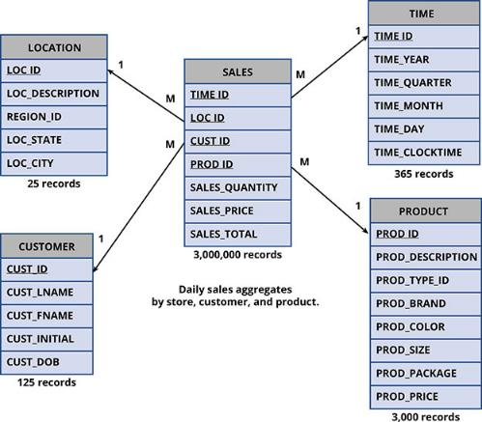
Star Schemas (3 of 5)
Figure 13.10 Star Schema for Sales

Slide 25
Star Schemas (4 of 5)
Performance-improving techniques for the star schema include the following:
  Normalizing Dimensional Tables
    Snowflake schema is a star schema in which dimension tables can have their own dimension tables
  Maintaining Multiple Fact Tables to Represent Different Aggregation Levels
    This technique saves processor cycles at run time, thereby speeding up data analysis
  Denormalizing Fact Tables
    Improves data access performance and saves data storage space

Slide 26
Star Schemas (5 of 5)
Performance-improving techniques for the star schema include the following (continued):
  Partitioning and Replicating Tables
    Partitioning splits tables into subsets of rows or columns and places them close to the client computer
    Replication makes a copy of a table and places it in a different location
    Periodicity provides information about the time span of the data stored in the table

Slide 27
Knowledge Check Activity 13-2
What is a data warehouse, and what are its main characteristics?

Slide 28
Knowledge Check Activity 13-2: Answer
What is a data warehouse, and what are its main characteristics?
Answer: A data warehouse is an integrated, subject-oriented, time-variant and non-volatile database that provides support for decision-making. (See section 13-4 for an in-depth discussion about the main characteristics.) The data warehouse is usually a read-only database optimized for data analysis and query processing.

Slide 29
Online Analytical Processing
Online analytical processing (OLAP) is a BI style whose systems share three main characteristics:
  Multidimensional data analysis techniques
  Advanced database support
  Easy-to-use end-user interfaces

Slide 30
Multidimensional Data Analysis Techniques
A characteristic of modern OLAP tools is their capacity for data to be processed and viewed as part of a multidimensional structure
  This type of data analysis is particularly attractive to business decision makers who tend to view business data as being related to other business data
Multidimensional data analysis techniques are augmented by the following functions:
  Advanced data presentation functions
  Advanced data aggregation, consolidation, and classification functions
  Advanced computational functions
  Advanced data-modeling functions

Slide 31
Advanced Database Support
OLAP tools must have the following features to deliver efficient decision support:
  Access to many different kinds of DBMSs, flat files, and internal and external data sources
  Access to aggregated data warehouse data and operational database detail data
  Advanced data navigation features
  Rapid and consistent query response times
  The ability to map end-user requests
  Support for very large databases

Slide 32
Easy-to-Use End-User Interfaces
When properly implemented, an analytical interface permits the user to navigate data in a way that simplifies and accelerates decision making or data analysis
Advanced OLAP features are more useful when access is kept simple
Many interface features are “borrowed” from previous generations of data analysis tools

Slide 33
OLAP Architecture (1 of 2)
Designed to meet ease-of-use requirements while keeping the system flexible
Main architectural components
  Graphical user interface (GUI)
  Analytical processing logic
  Data-processing logic

Slide 34
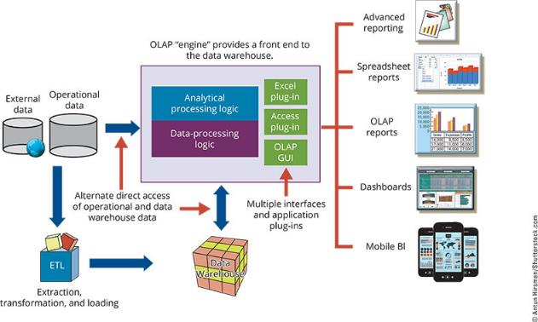
OLAP Architecture (2 of 2)
Figure 13.16 OLAP Architecture

Slide 35
Relational OLAP
Relational online analytical processing (ROLAP) provides OLAP functionality by using relational databases and familiar relational query tools to store and analyze multidimensional data
ROLAP adds the following extensions to traditional RDBMS technology
  Multidimensional data schema support within the RDBMS
  Data access language and query performance optimized for multidimensional data
  Support for very large databases (VLDBs)

Slide 36
Multidimensional OLAP
Multidimensional online analytical processing (MOLAP) extends OLAP functionality to multidimensional database management systems (MDBMSs)
  MDBMS uses proprietary techniques store data in matrix-like n-dimensional arrays
End users visualize stored data as a three dimensional data cube
Data cubes can grow to n number dimensions, thus becoming hypercubes
To speed data access, data cubes are normally held in memory in the cube cache
Sparsity measures the density of the data held in the data cube

Slide 37
Relational versus Multidimensional OLAP
Table 13.12 | Relational vs. Multidimensional OLAP
Characteristic | Rolap | Molap
Schema | Uses star schema Additional dimensions can be added dynamically | Uses data cubes Multidimensional arrays, row stores, column stores Additional dimensions require re-creation of the data cube
Database size | Medium to large | Large
Architecture | Client/server Standards-based | Client/server Open or proprietary, depending on vendor
Access | Supports ad hoc requests Unlimited dimensions | Limited to predefined dimensions Proprietary access languages
Speed | Good with small data sets; average for medium-sized to large data sets | Faster for large data sets with predefined dimensions

Slide 38
Data Analytics
Data analytics is a subset of business intelligence (BI) functionality that encompasses a wide range of mathematical, statistical, and modeling techniques with the purpose of extracting knowledge from data
  Explanatory analytics focuses on discovering and explaining data characteristics and relationships based on existing data
  Predictive analytics focuses on predicting future data outcomes with a high degree of accuracy

Slide 39
Data Mining (1 of 2)
Data mining refers to analyzing massive amounts of data to uncover hidden trends, patterns, and relationships; to form computer models to simulate and explain the findings; and then to use such models to support business decision making
Data mining focuses on the discovery and explanation stages of knowledge acquisition
Data mining consists of four general phases:
  Data preparation
  Data analysis and classification
  Knowledge acquisition
  Prognosis

Slide 40
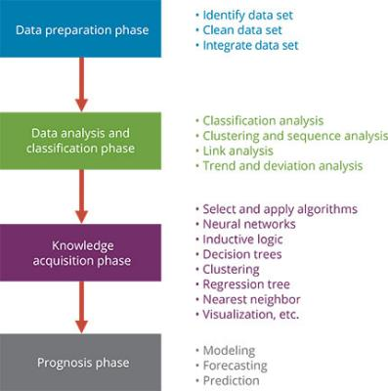
Data Mining (2 of 2)
Figure 13.19 Data-Mining Phases

Slide 41
Predictive Analytics
Predictive analytics focuses on creating actionable models to predict future behaviors and events
Predictive analytics employs mathematical and statistical algorithms, neural networks, artificial intelligence, and other advanced modeling tools to create actionable predictive models based on available data
Most predictive analytics models are used in areas such as healthcare services, customer relationships, customer service, customer retention, fraud detection, targeted marketing, and optimized pricing

Slide 42
SQL Analytic Functions (1 of 2)
The ROLLUP Extension
  The ROLLUP extension is used with the GROUP BY clause to generate aggregates by different dimensions
  It enables subtotal for each column listed except for the last one, which gets a grand total
The CUBE Extension
  The CUBE extension is also used with the GROUP BY clause to generate aggregates by the listed columns
  It enables you to get a subtotal for each column listed in the expression, in addition to a grand total for the last column listed

Slide 43
SQL Analytic Functions (2 of 2)
Materialized Views
  A materialized view is a dynamic table that contains SQL query command to generate rows and stores the actual rows
  It is created the first time the query is run and the summary rows are stored in the table
  The materialized view rows are automatically updated when the base tables are updated
  To create materialized views, you must have specified privileges and you must complete specified prerequisite steps

Slide 44
Data Visualization (1 of 2)
Data visualization is the process of abstracting data to provide a visual data representation that enhances the user’s ability to comprehend the meaning of the data
  The goal is to allow the user to quickly and efficiently see the data’s big picture by identifying trends, patterns, and relationships
The Need for Data Visualization
  The ability to zoom in and out, drill down and up, filter, etc. is one of the many advantages of current breed of data visualization tools
  Another advantage of data visualization is that it makes it easier to understand data—in particular, large amounts of data

Slide 45
Data Visualization (2 of 2)
The Science of Data Visualization
  Data visualization has its roots in cognitive sciences, which is the study of how the human brain receives, interprets, organizes, and processes information
  Data visualization can be used to explore and discover data insights by applying:
    Pattern recognition, spatial awareness, and aesthetics
Understanding the Data
  In general, there are two types of data:
    Qualitative: describes qualities of the data
    Quantitative: describes numeric facts or measures of the data

Slide 46
Data Lake
A data lake is a mega data repository that stores all company data (structured, semi-structured, and unstructured) in its raw/natural format
The idea of the data lake is to store the data in its raw/natural state before it is processed
The data lake can also serve as the source data for data scientists to “fish” for data relationships and patterns in the raw data before it is processed

Slide 47
Knowledge Check Activity 13-3
What is data analytics?

Slide 48
Knowledge Check Activity 13-3: Answer
What is data analytics?
Answer: Data analytics is a subset of BI functionality that encompasses a wide range of mathematical, statistical, and modeling techniques with the purpose of extracting knowledge from data. Data analytics is used at all levels within the BI framework, including queries and reporting, monitoring and alerting, and data visualization.

Slide 49
Summary (1 of 2)
Now that the lesson has ended, you should be able to:
Describe the role of business intelligence in providing comprehensive business decision support
Describe the architecture, reporting styles, evolution, and benefits of business intelligence
Differentiate between operational data and decision support data
Identify the purpose, characteristics, and components of a data warehouse
Develop star and snowflake schemas for decision-making purposes

Slide 50
Summary (2 of 2)
Now that the lesson has ended, you should be able to (continued):
Describe the characteristics and capabilities of online analytical processing (OLAP)
Describe the role and functions of data analytics and data mining
Explain how SQL analytic functions are used to support data analytics
Define data visualization and explain how it supports business intelligence
Define a data lake

