Slide 2
Databases Made Tasty:
MindTap, Cookbooks & AI
Hanadi Alnawab
Professor & Program Coordinator
Humber Polytechnic
Canada

Slide 3
Agenda
Background & Context
Teaching Resources & Approach
Project Work: Cookbooks
  What-to: Database Planning Workbook
  How-to: MindTap
Student Feedback
Next Steps

Slide 4
Background: Program & Course
Program: Digital Business Management - Bachelor of Commerce
  4 year degree program
Course: Database Systems
  Semester 6
  3rd year students
  14 weeks (includes midterm & final exams)
  Just before their Work-Placement

Slide 5
About the Database Systems Course
Key Concepts Covered:
Design, development, and management of relational database systems.
Hands-on development using Microsoft Access
Assessments:
Written exams (midterm and final).
Hands-on work (individual and group).

Slide 6

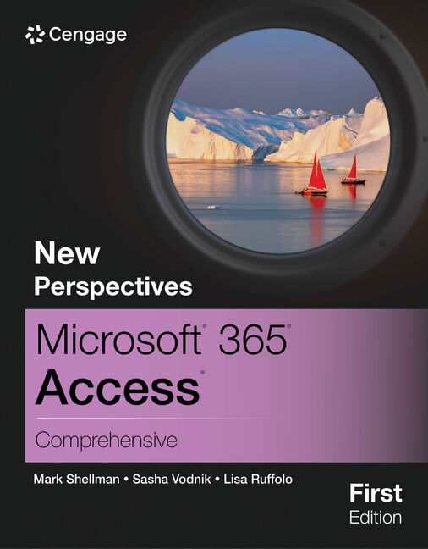
Teaching Resouces: Approach
What-to
How-to

Slide 7
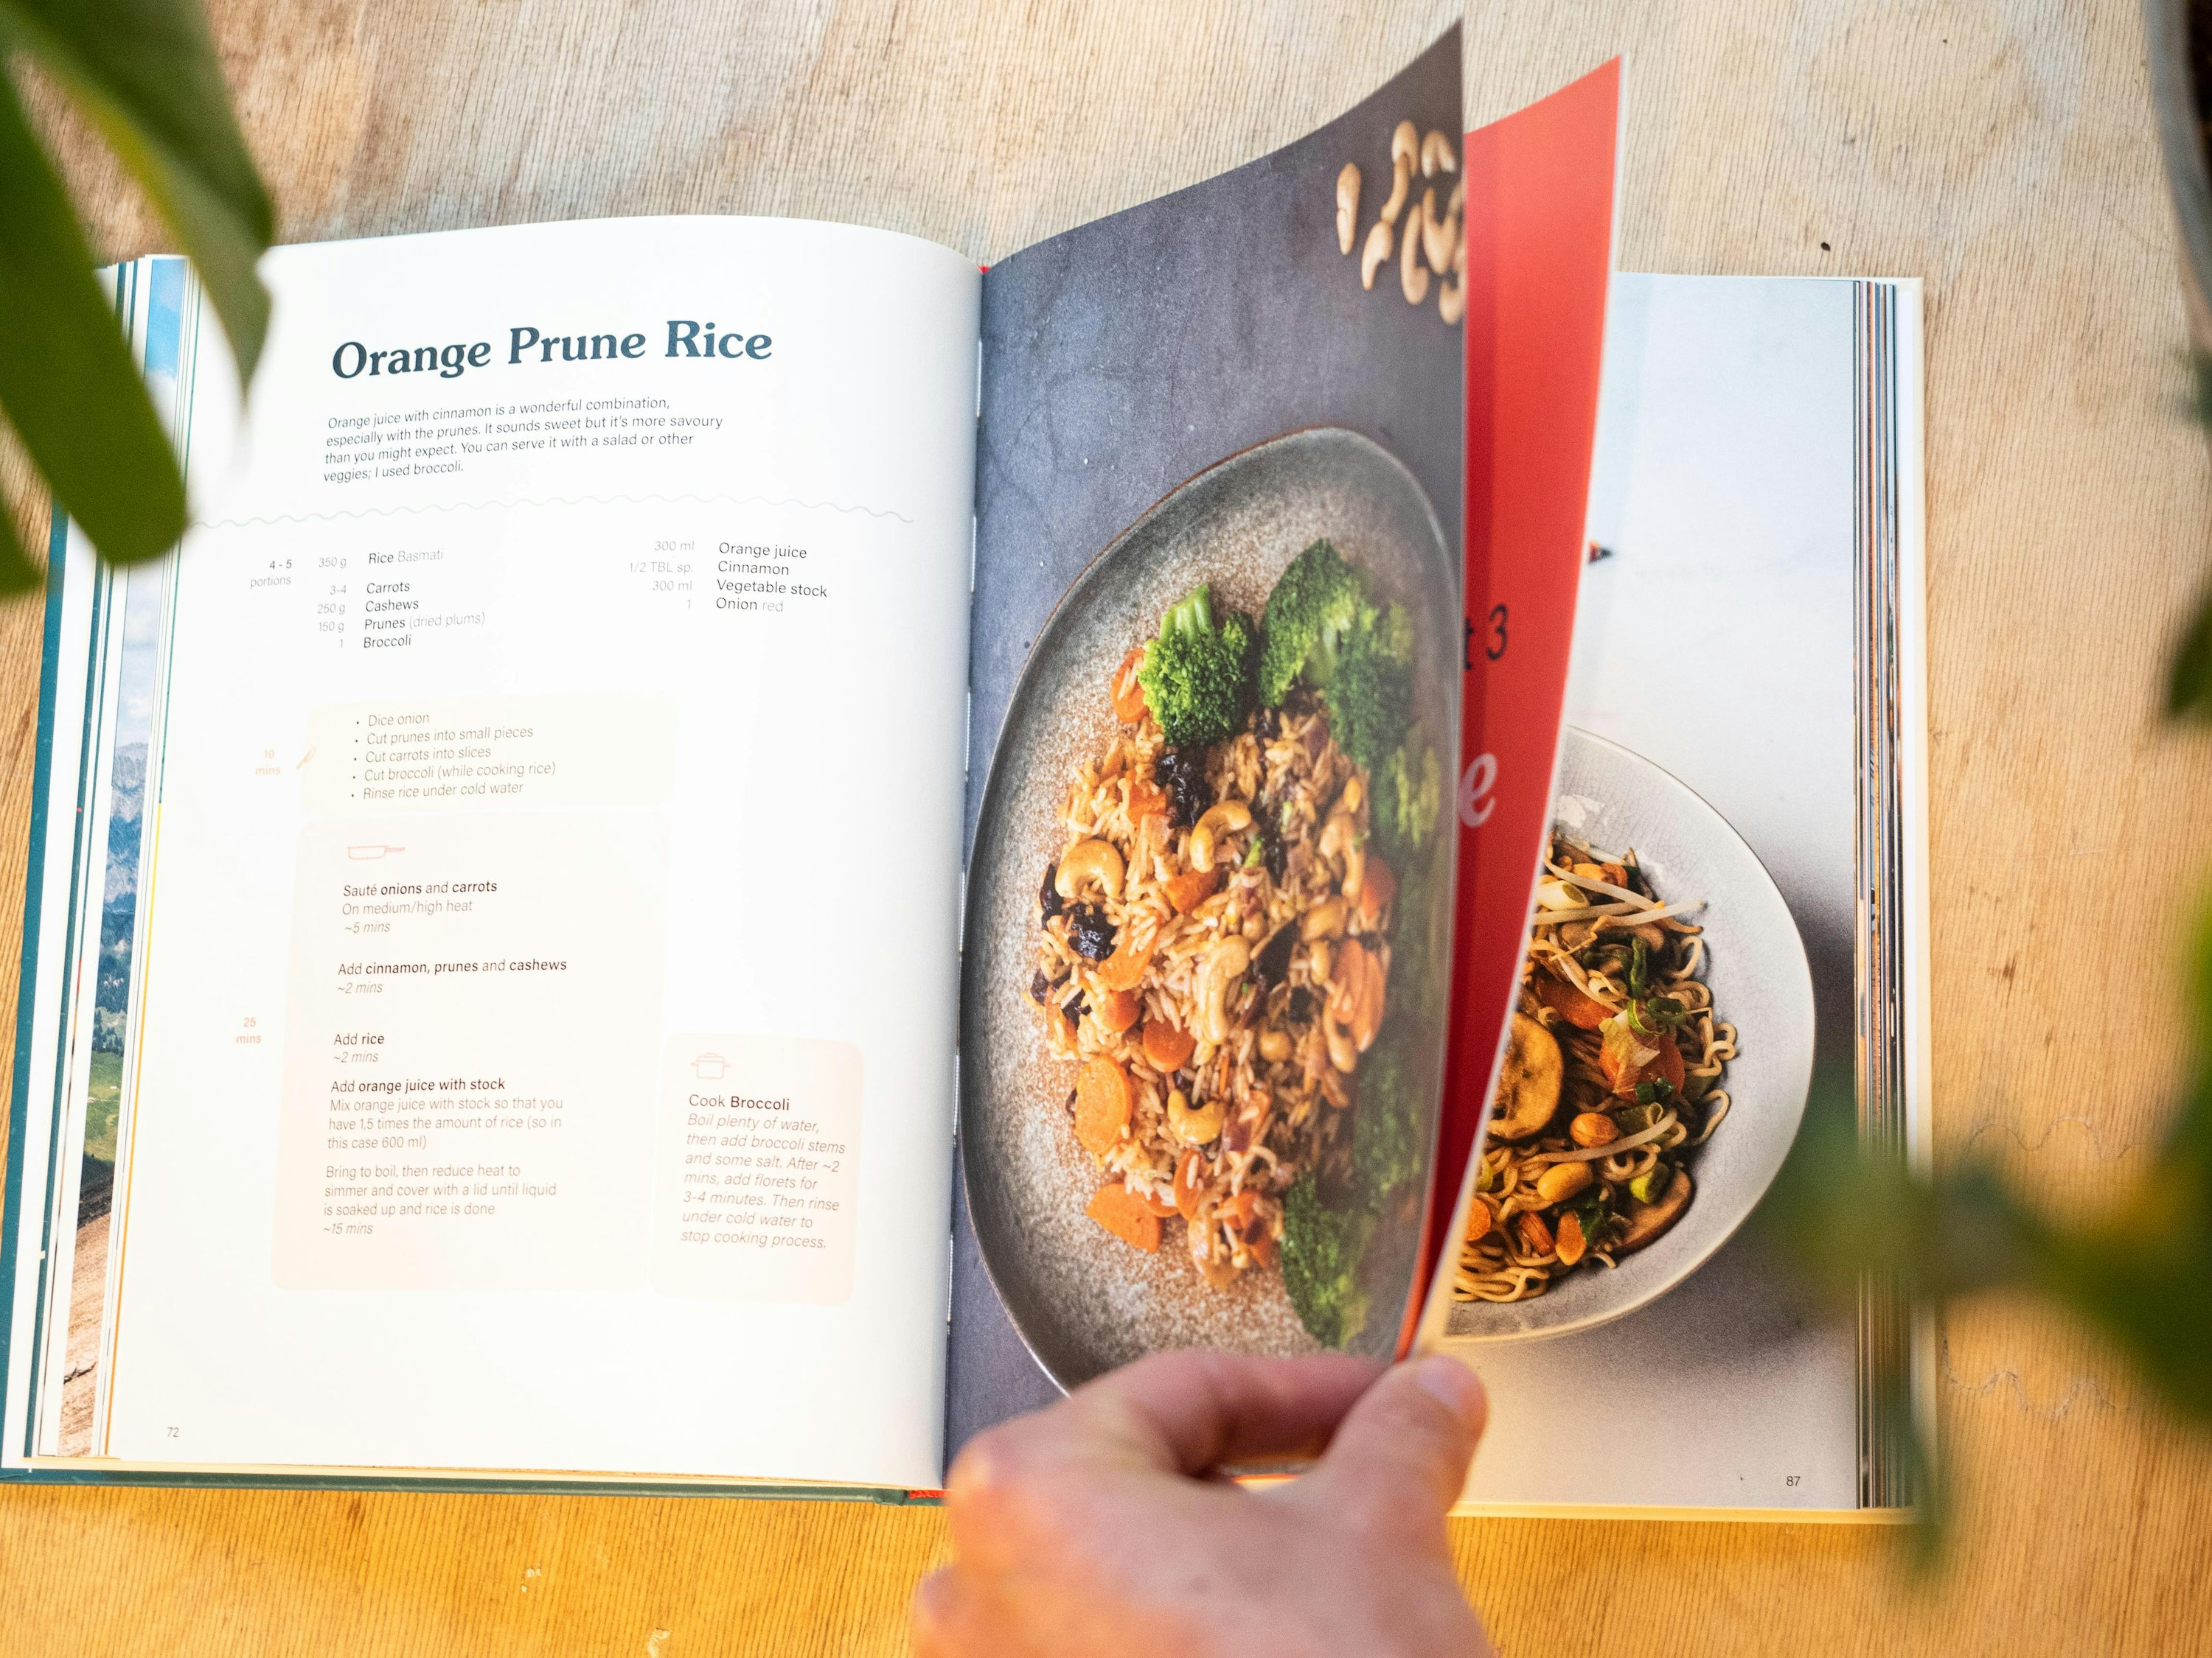
Project Work
Cookbooks
Notes:
Thought about cookbooks as I needed a physical element to start the project.
Cookbooks are a great example for inconsistencies in data & format
Our librarian suggested music albums as well

Slide 8
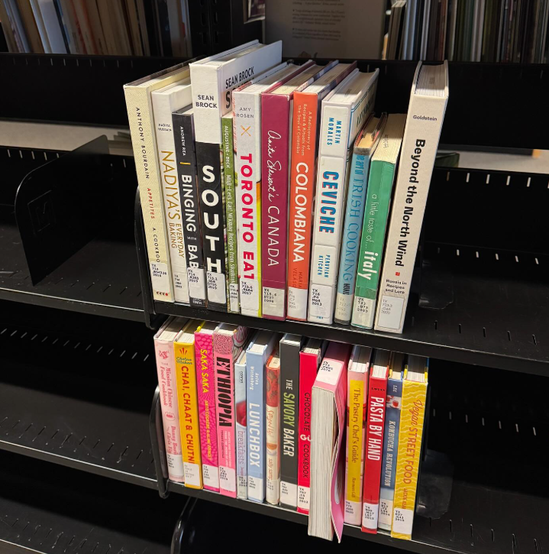
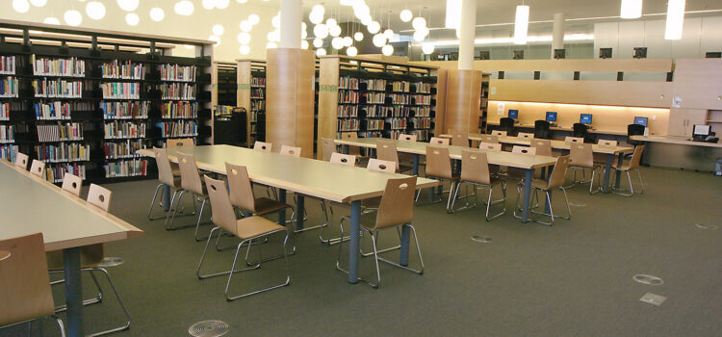
Visit to the Library
What-to

Slide 9
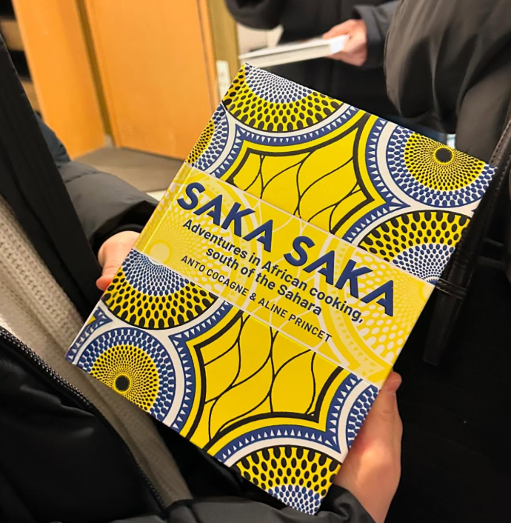
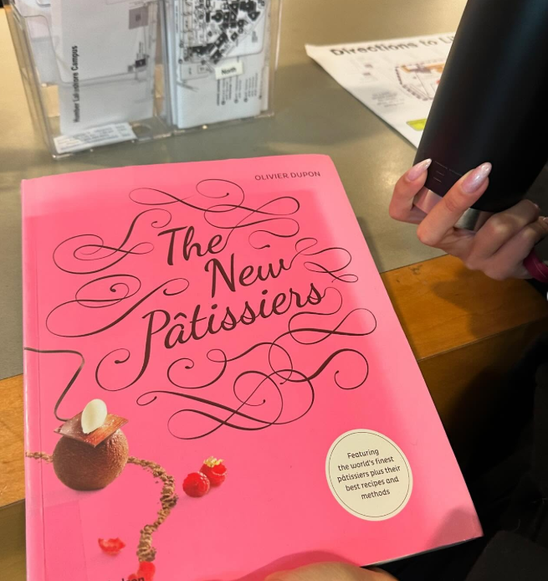
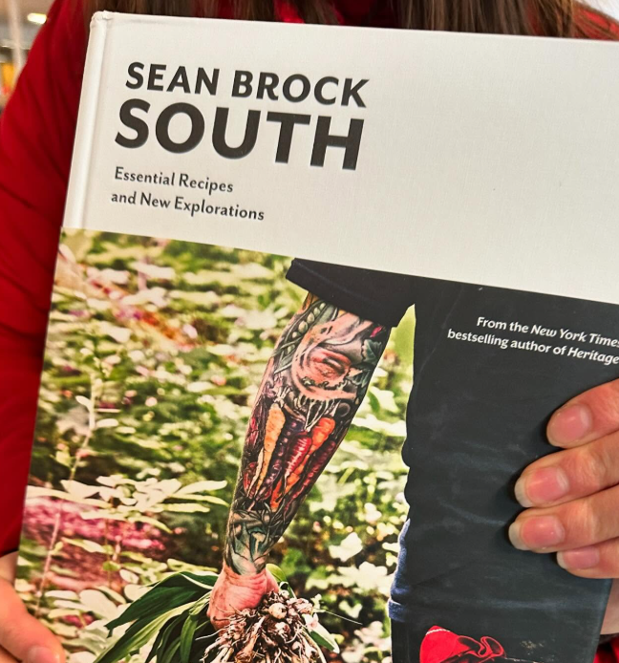
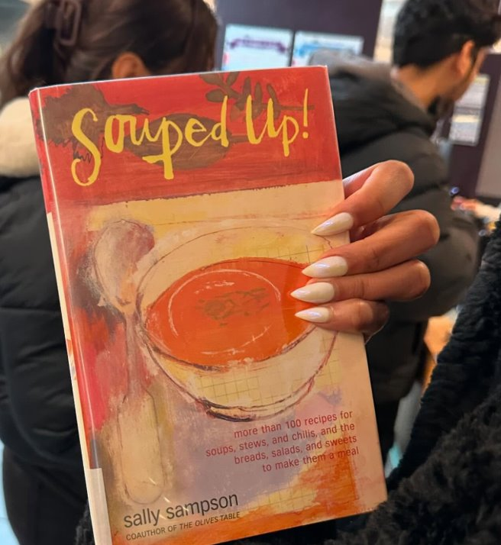
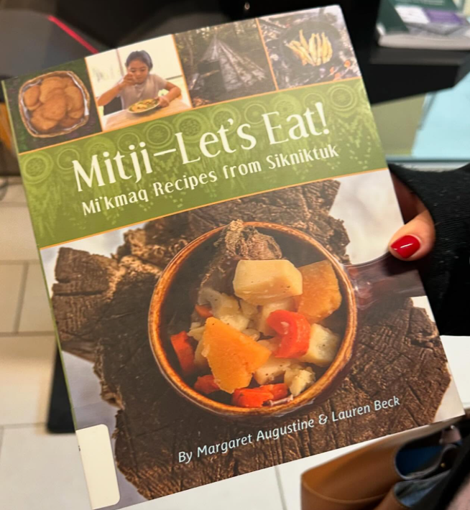
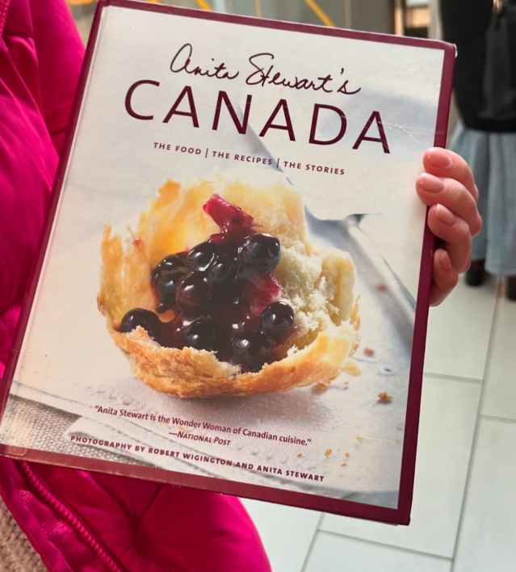
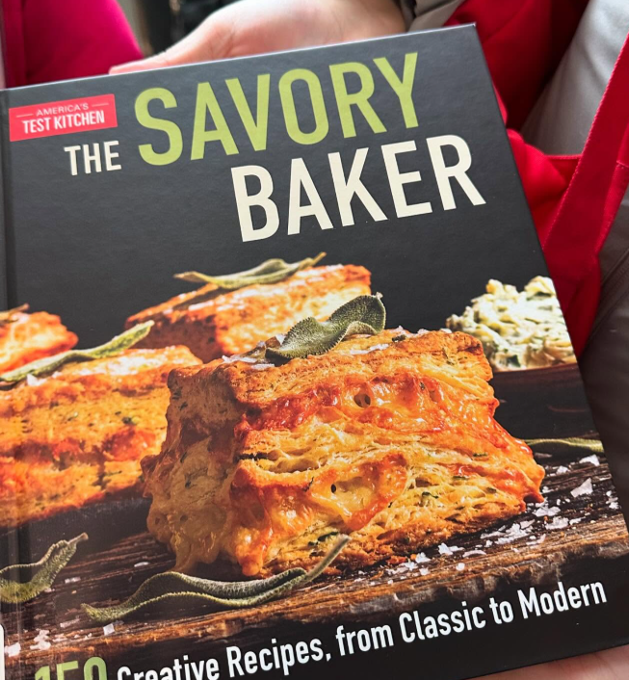
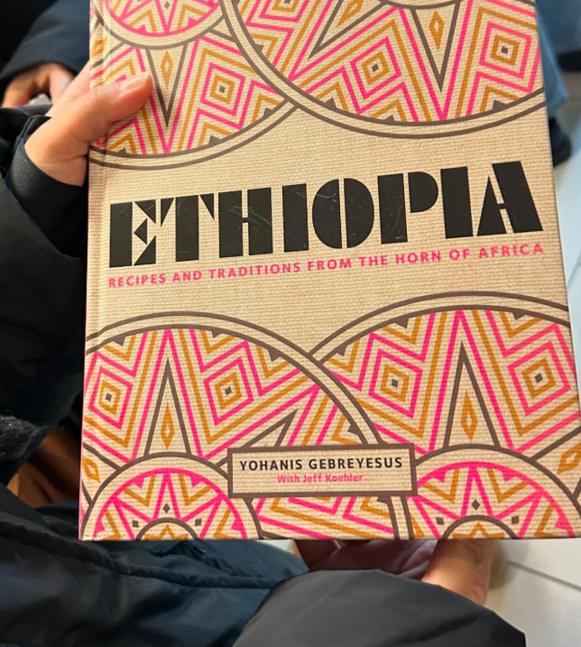

Slide 10
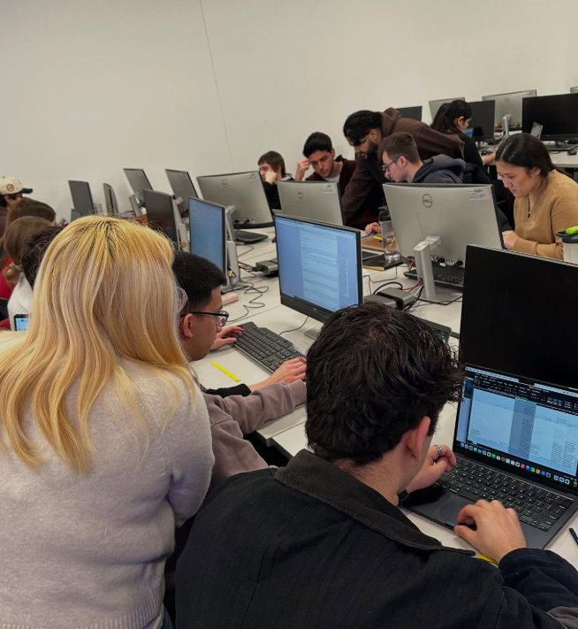
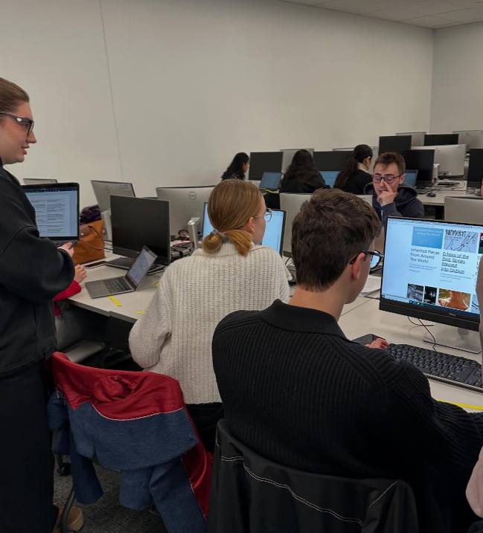
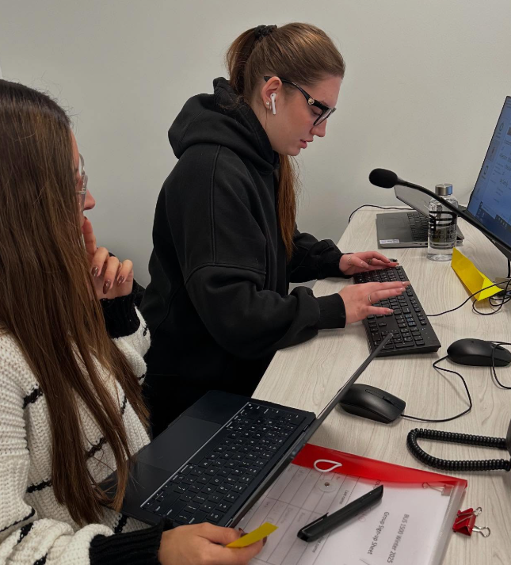
Back to the Classroom
Groups of 4

Slide 11
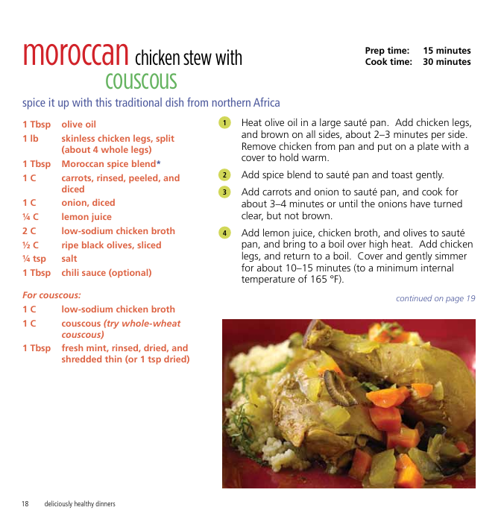
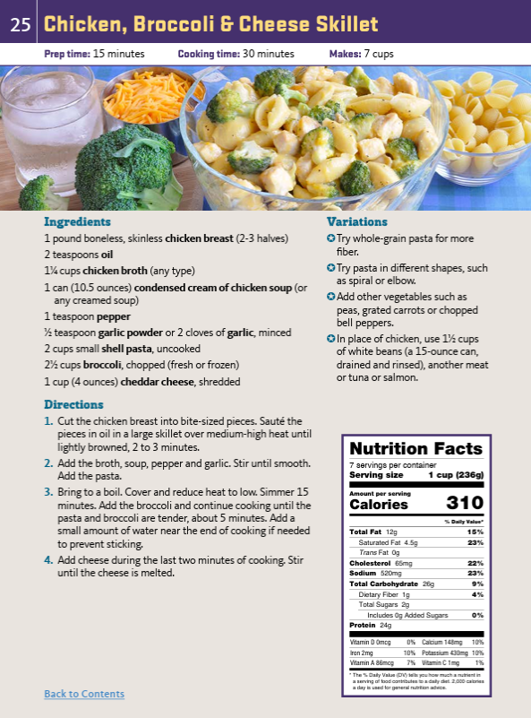
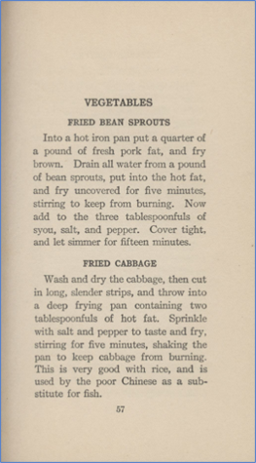
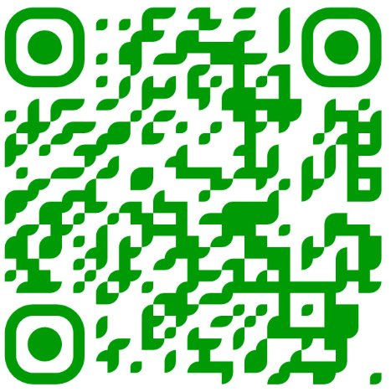
Recipes
Structure, nutrition into, units, images ...etc
Notes:
Recipe print-outs will be distributed

Slide 12
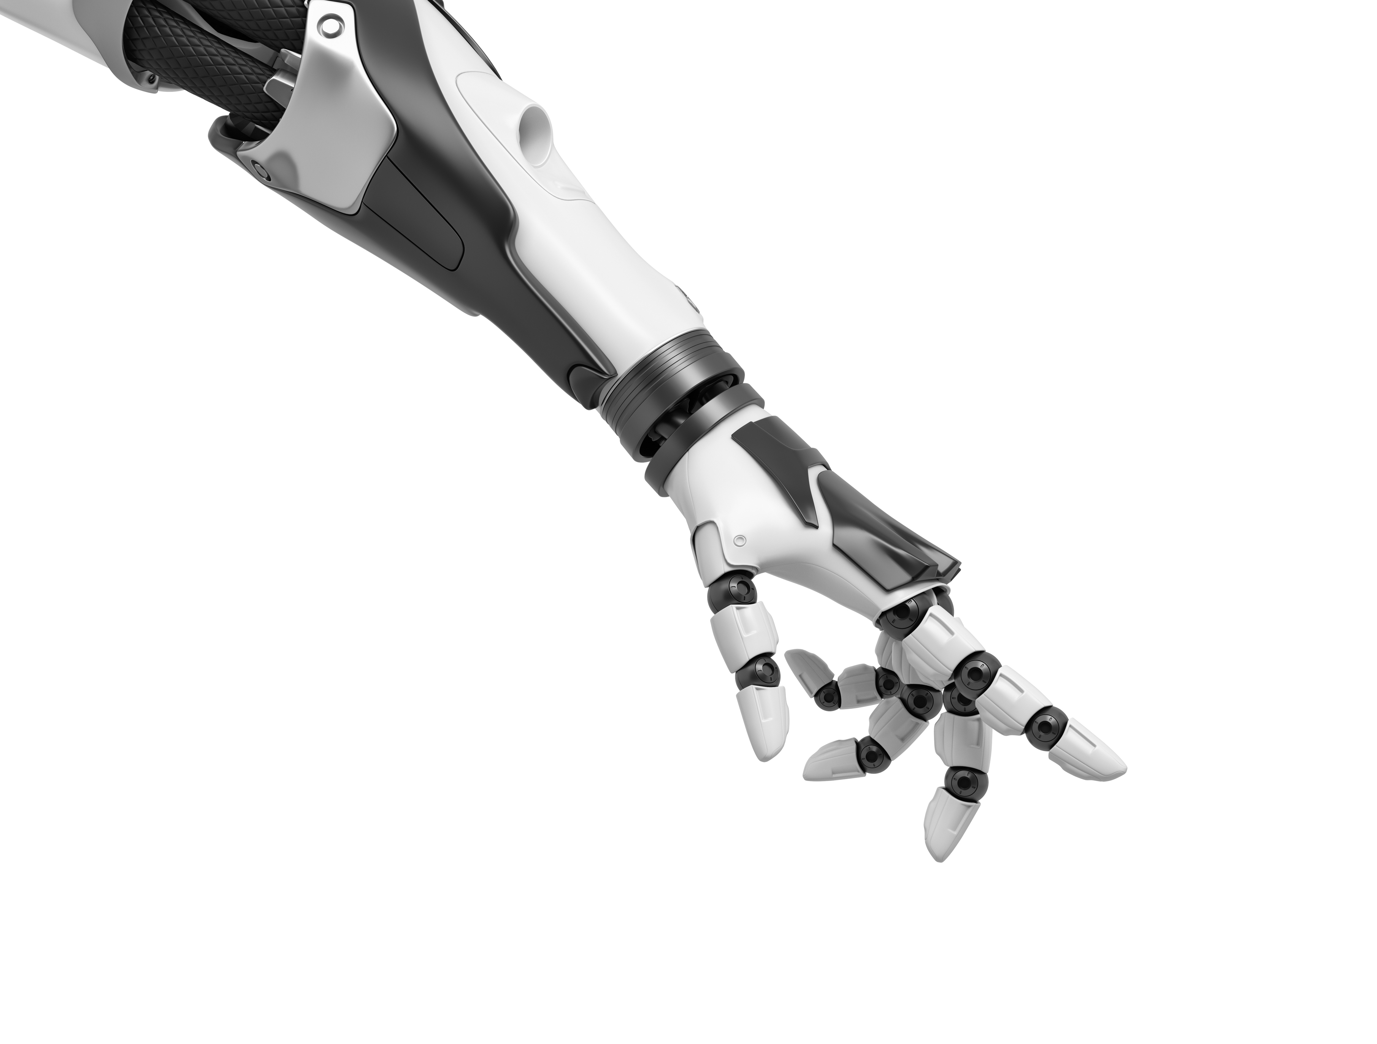
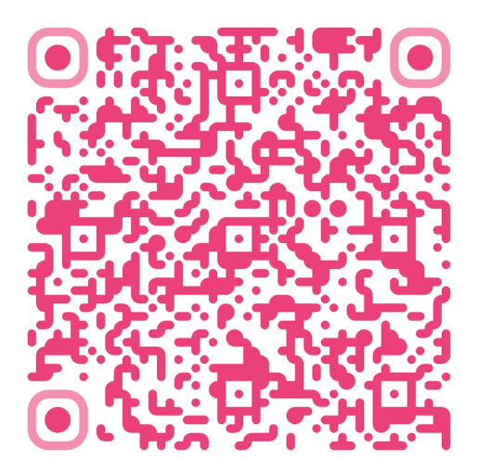
created with AI's help
Workbook
Notes:
https://docs.google.com/document/d/1ckjheaj34eY8ACibvhxb9l9_pGRqok1XaC1DmGzhk-I/edit?usp=sharing

Slide 13
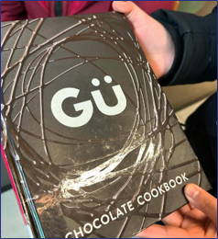
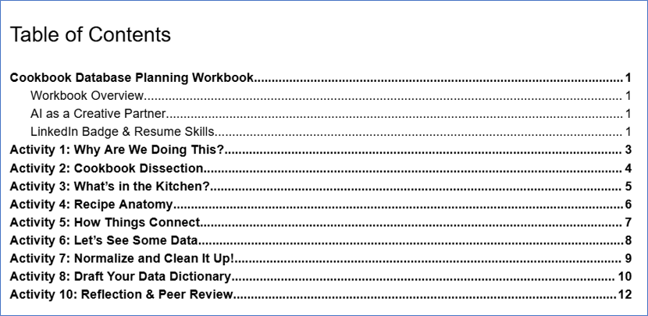
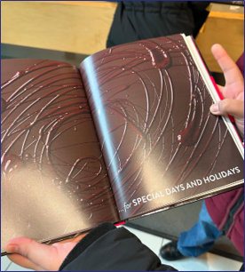
Database Planning Workbook
Weekly in-class group activities

Slide 14
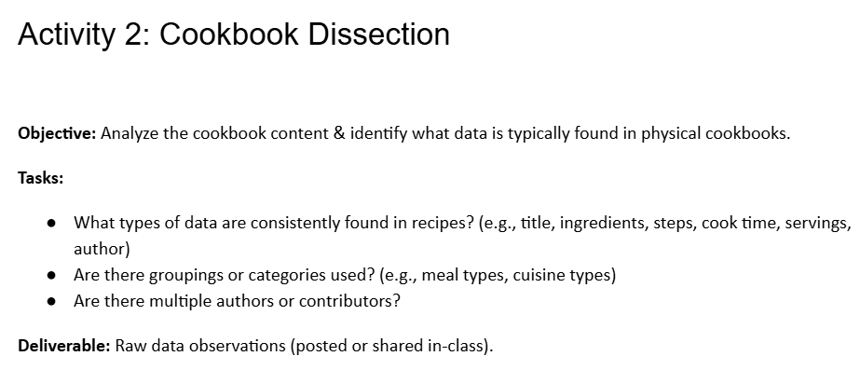
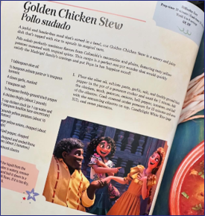
Students look for similarities and differences

Slide 15
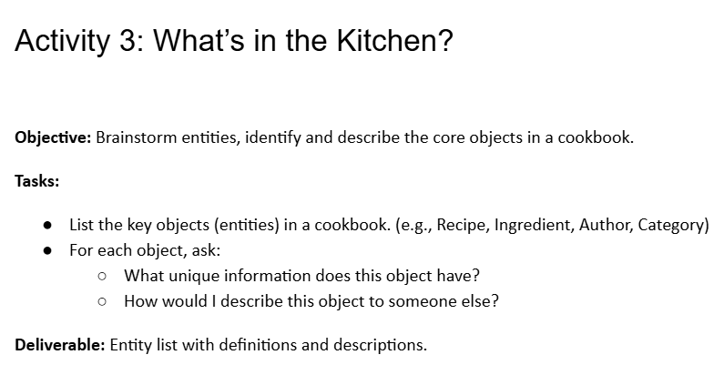
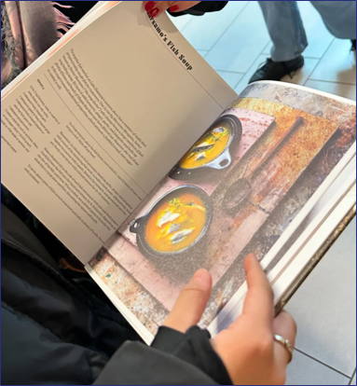
Introduce database terminology

Slide 16
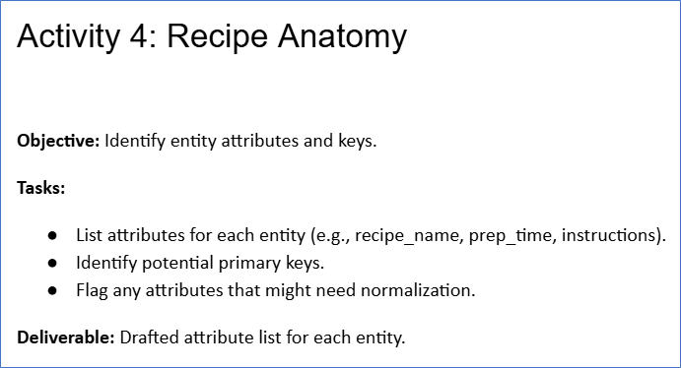
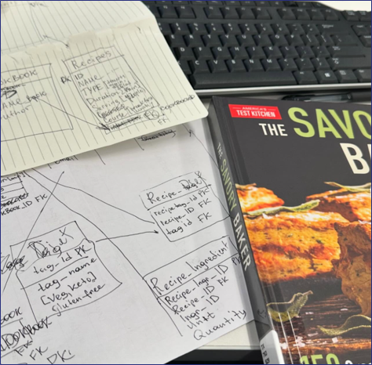
Introduce database terminology

Slide 17
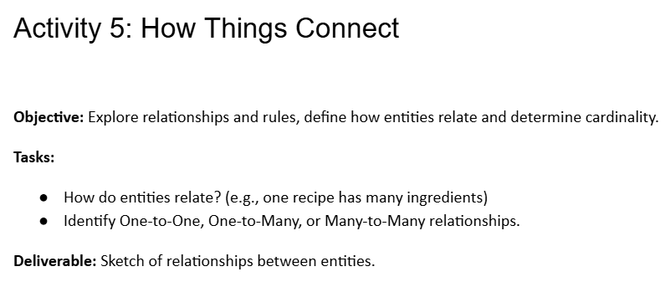
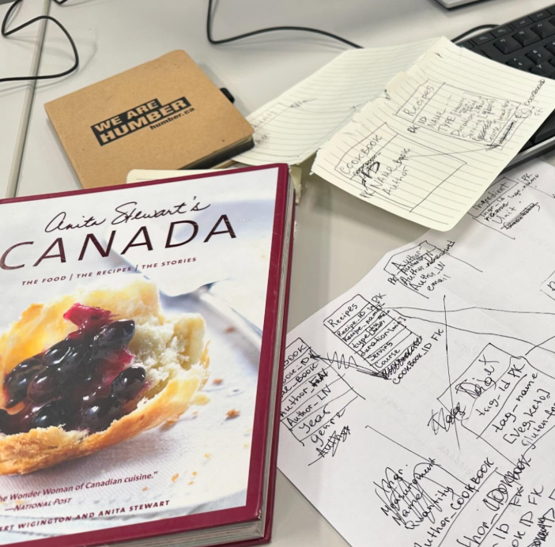
Introduce relationships & business rules

Slide 18
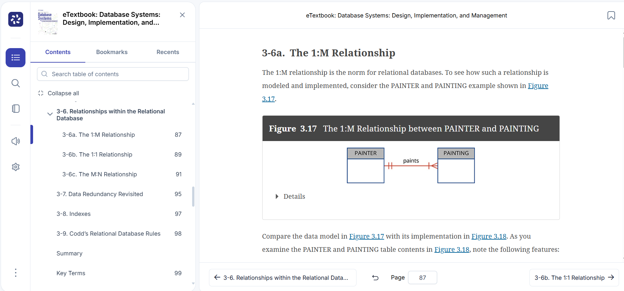

Slide 19
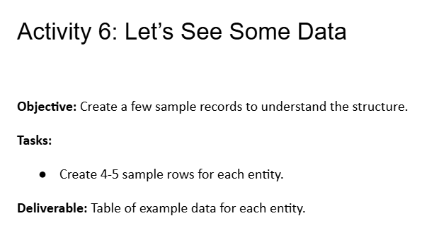
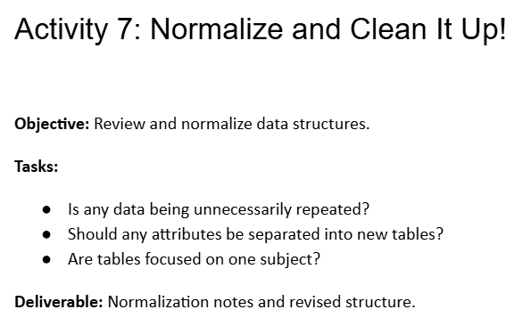
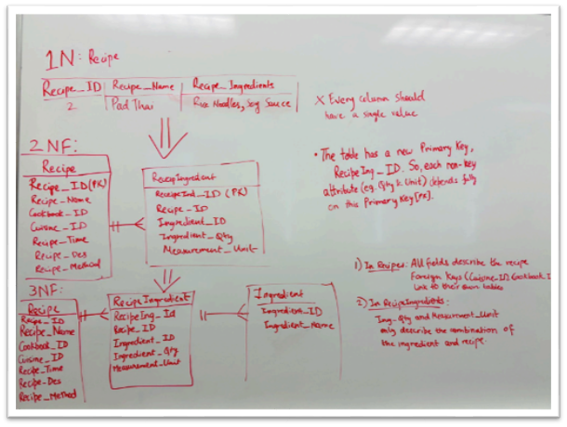
Introduce data redundancies
Finalize tables
Student Work Sample

Slide 20
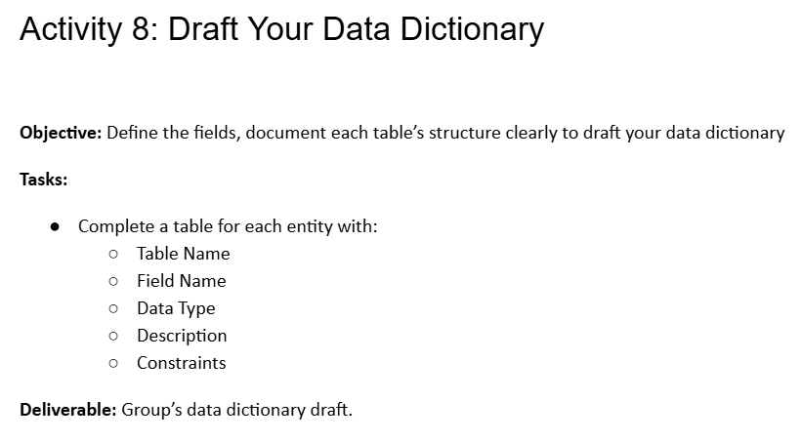
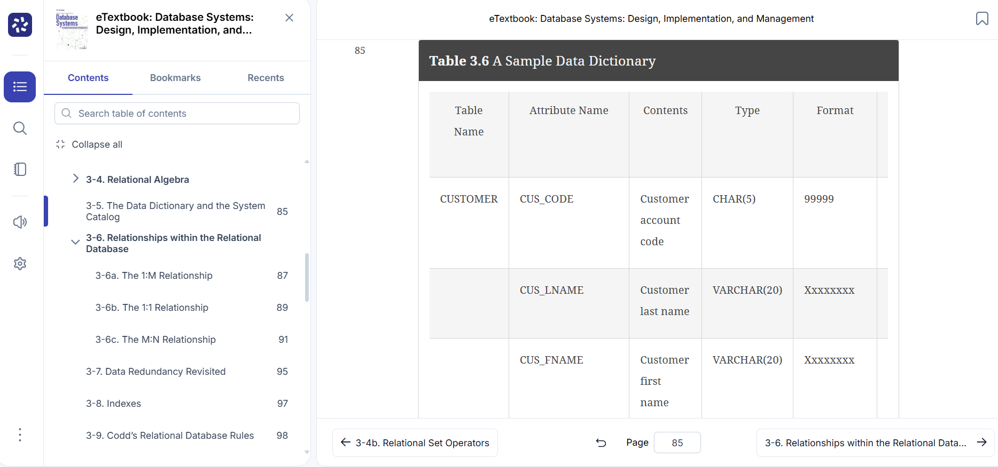

Slide 21
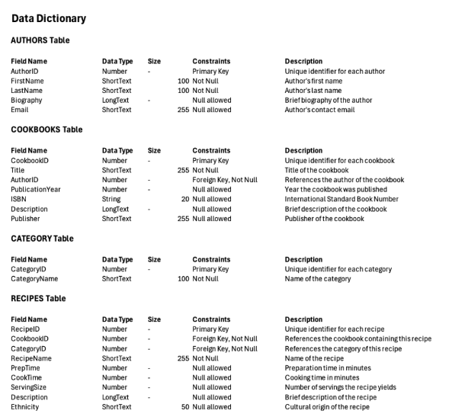
Student Work Sample

Slide 22
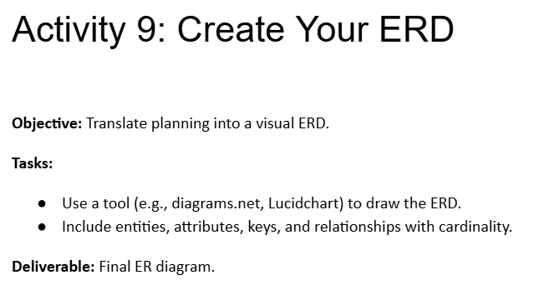
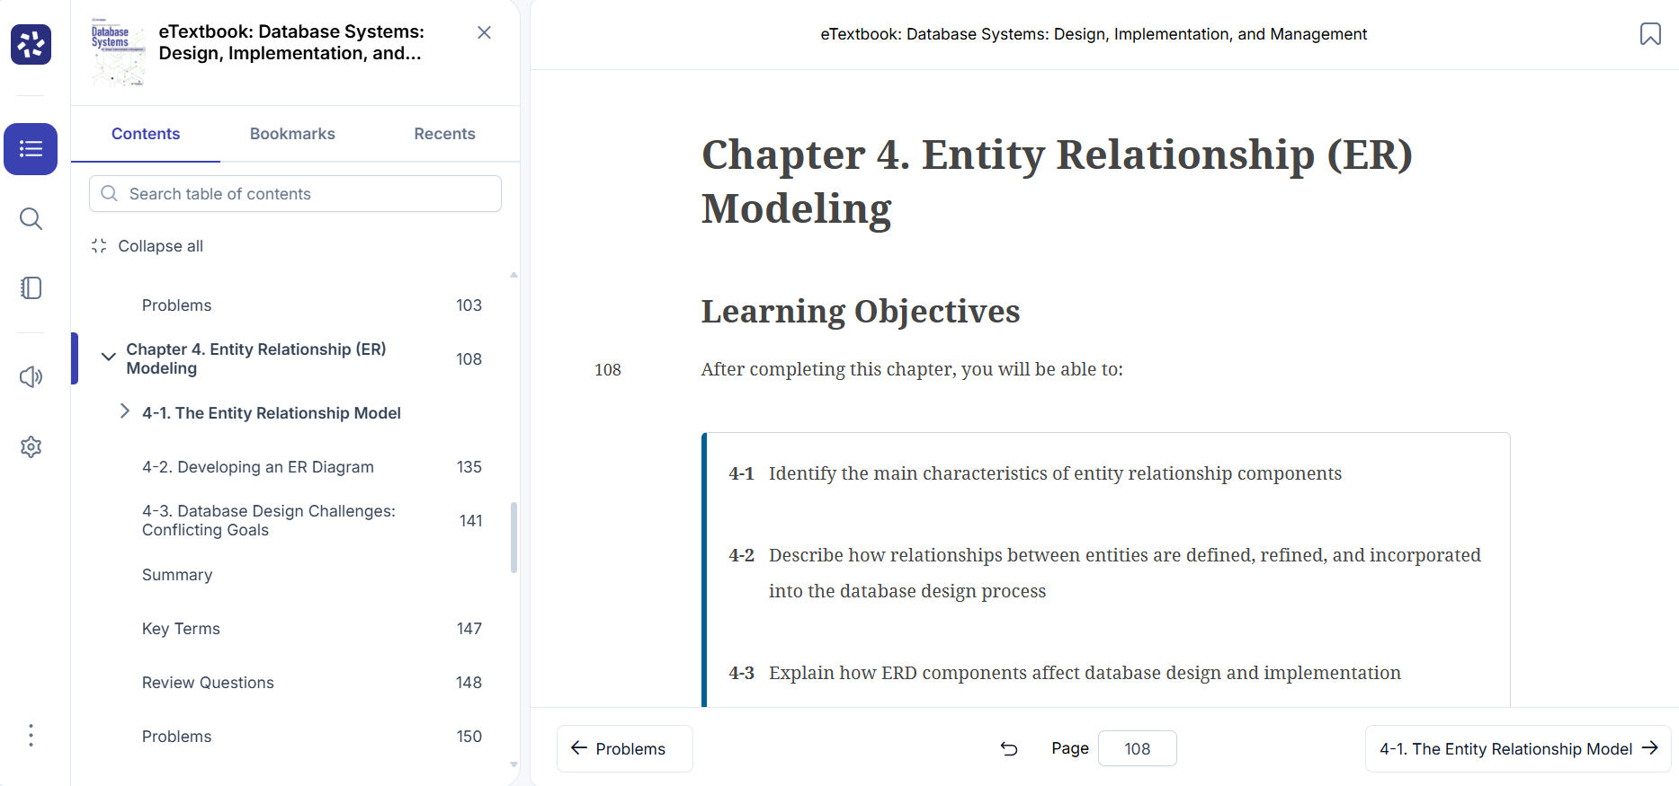

Slide 23
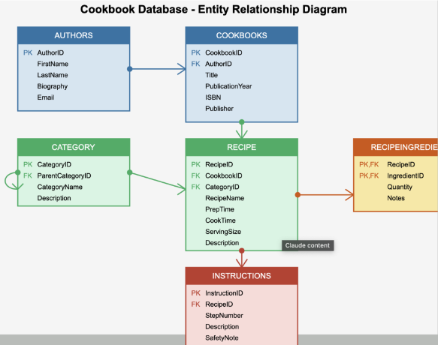
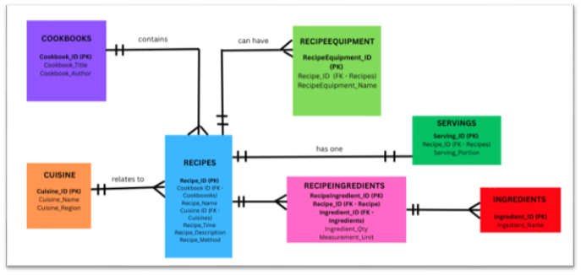
Student Work Sample

Slide 24
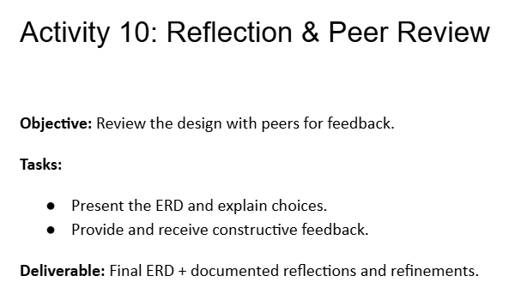
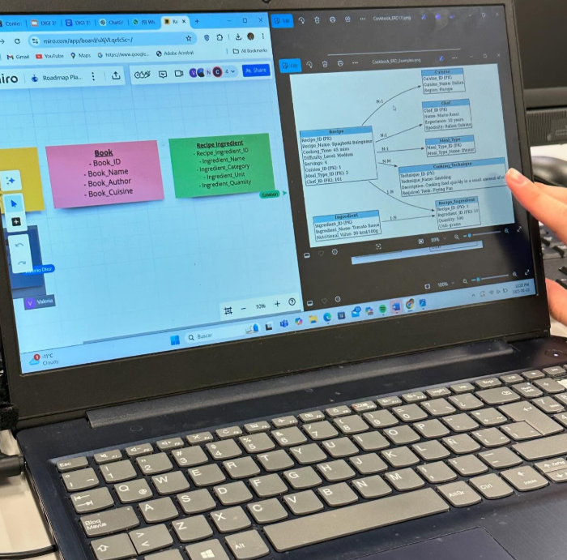

Slide 25
What-to
How-to

Slide 26
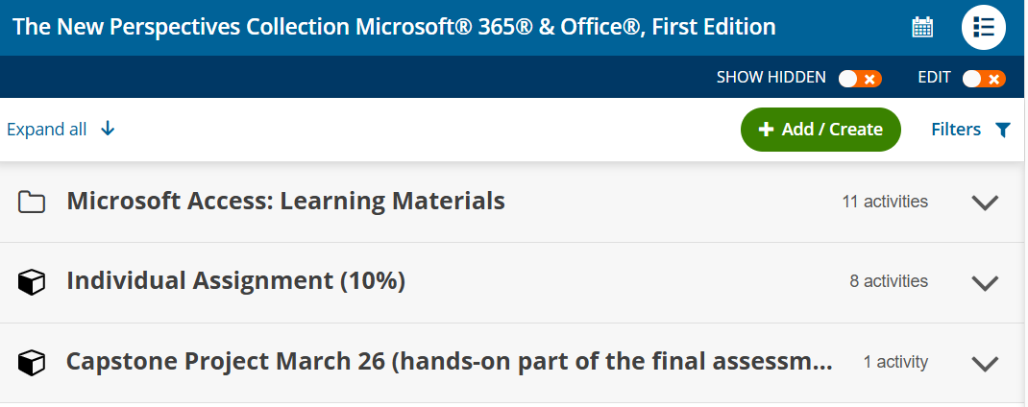
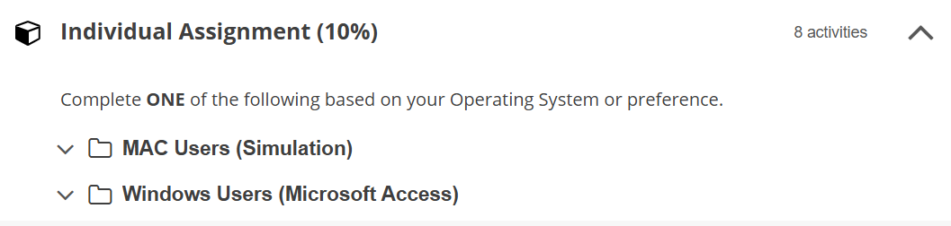
MindTap

Slide 27
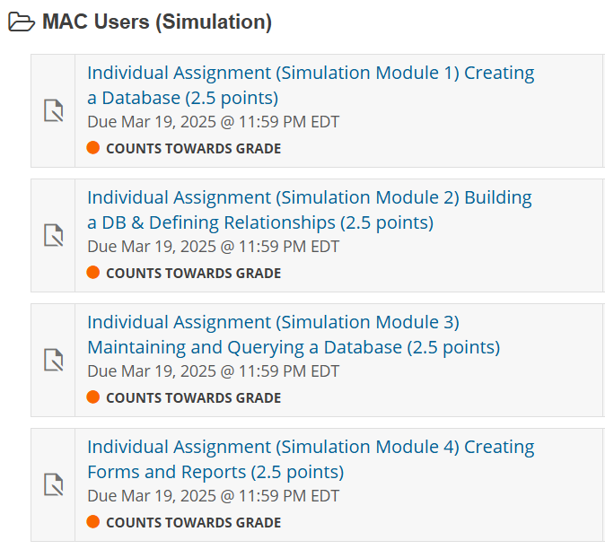
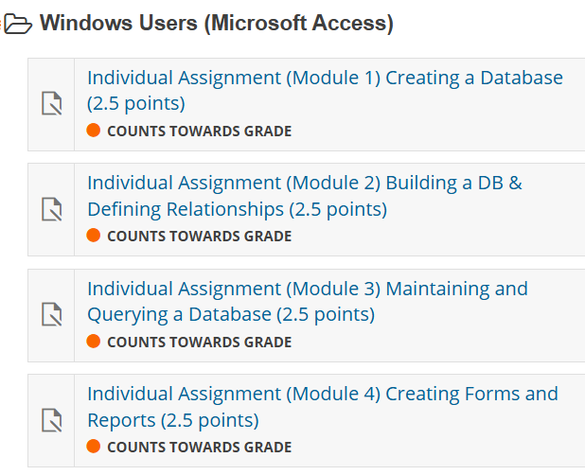

Slide 28
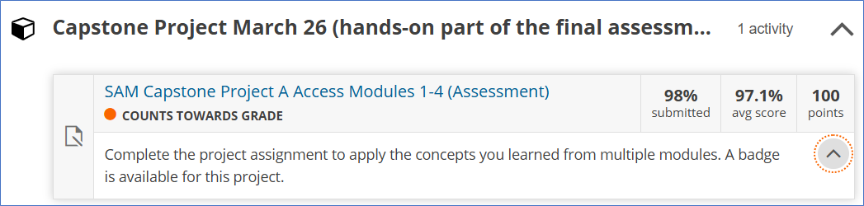
Capstone Project
Open book, in-person, during class-time
Multiple attempts (unlimited)
Ask a friend: if you don't have a friend, make a friend!

Slide 29


Putting them Together
Final group project: what-to + how-to
Student teams used their Ms Access knowledge to build the Cookbooks database
Presented the whole process
Student Work Sample

Slide 30






Student Work Sample

Slide 31

Student Feedback
In their own words …
"I talked about it in a job interview"
"MindTap was great practice"
"Creating the Cookbook DB was straightforward"

Slide 32



Field Trip:
NTN Bearing Canada

Slide 33
NEXT STEPS
The "Why"?
Notebook
Cookbook DB Coach
Bongo

Slide 34

The "Why"?
WHY?
What-to
How-to
Notes:
Layered learning models like Simon Sinek's Golden Circle and the Three Horizons approach to innovation.

Slide 35
A Third Layer
Why?
WHY
What-to
WHAT
HOW
How-to
Breadth Elective: Thinking in Systems
Notes:
Layered learning models like Simon Sinek's Golden Circle and the Three Horizons approach to innovation.

Slide 36
The Three Layers
WHY | Systems Thinking | Understand the broader purpose and users of the database
WHAT | Database Design | Plan tables, relationships, ERD, normalization
HOW | Microsoft Access | Implement the database: tables, queries, forms, and reports
WHY
WHAT
HOW
Notes:
Layered learning models like Simon Sinek's Golden Circle and the Three Horizons approach to innovation.

Slide 37




Notes:
Photo by Frederick Shaw on Unsplash
Photo by Anastasiya Chervinska on Unsplash
Photo by Sweet Life on Unsplash
Photo by Dari lli on Unsplash

Slide 38
Systems Thinking: Examples
Scenario | Broader System | Purpose of Database
Helping high school students eat healthier | Public health, youth education | A recipe database curated for teens with simple meals, cost tracking, and nutrition labels
Preserving cultural heritage | Immigration, cultural studies | A multilingual recipe archive from immigrant communities
Supporting seniors | Aging population, food insecurity | A voice-accessible database of easy recipes with dietary filters
Notes:
Layered learning models like Simon Sinek's Golden Circle and the Three Horizons approach to innovation.

Slide 39


Slide 40
NEXT STEPS
The "Why"?
Notebook
Cookbook DB Coach
Bongo

Slide 41


Notebook (one per team)
20 / 60 / 20
Tangible, low-tech, reflective, builds team ownership, storytelling and documentation skills.
A "Journal Prompt" is provided each week based on the activity and project progress.
Use for sketches, doodles, decisions, ideas, reflections, stickers …etc.
To be used in their final presentation.
Notes:
Layered learning models like Simon Sinek's Golden Circle and the Three Horizons approach to innovation.

Slide 42
NEXT STEPS
The "Why"?
Notebook
Cookbook DB Coach
Bongo

Slide 43
Cookbook DB Coach; inspired by:
“Reimagining Education: AI-Driven Course Design”, a Cengage webinar by Jonathan Carrigan, Durham College.
“Custom GPTs – Interactive Simulations”, a Professional Development session by Jeff Short, Humber Polytechnic.

Slide 44

Cookbook DB Coach (student-facing)
Custom GPT: Cookbook DB Coach
Knowledge Uploaded:
  Course Outline
  Critical Path
  Project Instructions
  Cookbook Planning Workbook

Slide 45


Slide 46
NEXT STEPS
The "Why"?
Notebook
Cookbook DB Coach
Bongo

Slide 47

Bongo: inspired by
Cengage webinar:
Building Real-World Skills With AI-Powered Assessments
Presented by:
  Sandy Keeter, Professor, Seminole State College
  Emily McLellan, VP, Partner and Customer Experience, Bongo
  Dr. Marc Wilson, Professor, Program Director, Fisher College

Slide 48

Bongo: Job Interview Simulation

Slide 49


Slide 50


Bongo: Job Interview Simulation

Slide 51
Bongo: Job Interview Simulation
Can you tell me about a database project you worked on during your studies?
What database tools or platforms are you most familiar with? (e.g., MS Access)
How did you learn SQL, and how comfortable are you writing queries from scratch?
Walk me through how you would design a relational database for a small business (e.g., bakery).
How do you handle many-to-many relationships in a database?
Have you created an ERD Entity Relationship Diagram? What tools did you use?
What did you find most challenging about working with databases as a student?
Why are you interested in pursuing a career in database systems?
Are there any areas in database systems you’d like to explore further

Slide 52



Slide 53

Thanks to our Canadian Cengage Team!
Kristina Leone
Darcey Pepper
Caitlin Smith
Maria Boryczko
Todd Latta

